Slide 1
HRM Liaisons Meeting
April 2023 Meeting

Slide 2
HRM Updates
Dr. Tranell E. Barton, Learning & Development Trainer

Slide 3

Human Resources Management
nohrm@lsuhsc.edu
Staffing Update!
Myra Christophe
mchri4@lsuhsc.edu
Human Resources Specialist

Slide 4
Human Resources Management
nohrm@lsuhsc.edu
A Word from Kevin Oufnac
Kevin Oufnac
Chief Counsel
koufna@lsuhsc.edu
504-568-3250
Cynthia Scott
Claims Analyst
cscott1@lsuhsc.edu
504-568-4801

Slide 5
HRM Compensation
Sara Schexnayder, HRM Compensation Manager

Slide 6
HRM Compensation nohrmcompensation@lsuhsc.edu
Merit and Equity
Awaiting approval for FY2024
Plan to get files to schools next week
Due date will be May 18
Effective date July 1
Equity will be planned by the schools
  Will need a rationale for all equity increases
Unclassified Salary Structure
Structure will move effective 5/1/23
New ranges to be sent to business managers

Slide 7
HRM Benefits
Beth Worthen, Benefits & Retirement Manager

Slide 8
HRM Benefits
nohrmbenefits@lsuhsc.edu
457(b) Supplemental Retirement
Will Parrie with Empower will be scheduling sessions on May 10, 2023
Location: Study Room 3110 (across from the MEB cafeteria)
To schedule a meeting go to Will Parrie Booking Site or call 504-247-5996
More information regarding supplemental retirement benefits can be found at : https://www.lsuhsc.edu/administration/hrm/supplemental_retirement.aspx

Slide 9
HRM Benefits
nohrmbenefits@lsuhsc.edu
403(b) Supplemental Retirement
Louis Bundy with TIAA will be scheduling sessions on May 30, 2023
Location: Study Room 3108 (across from the MEB cafeteria)
To schedule a meeting contact louis.bundy@tiaa.org
More information regarding supplemental retirement benefits can be found at : https://www.lsuhsc.edu/administration/hrm/supplemental_retirement.aspx

Slide 10
HRM Benefits
nohrmbenefits@lsuhsc.edu
Prudential Pathways Event
3-Part Series:
A series of engaging onsite financial wellness seminars:
Setting your financial goals
Protecting your assets through risk management
Investment principles
Healthcare planning
Retirement and asset distribution strategies
Tax strategies
Estate planning strategies
How your benefits fit into your overall financial wellness
May 2, 2023 from 10:00-11:00am
May 3, 2023 from 2:00-3:00 pm
Register Now!

Slide 11
HRM Talent Acquisition
Shauna Caputo, Talent Acquisition Manager

Slide 12
HRM Talent Acquisition
recruittalent@lsuhsc.edu
Update to Qualifying Questions in People Admin
Beginning Monday April 3rd, Talent Acquisition & Operations has begun updating all qualifying questions on Unclassified Staff & Administrative Faculty postings to allow applicants who will receive required degree and/or certification (as indicated in the approved position description) by start date.
The purpose of this change is to broaden applicant pools and improve our recruitment efforts with new talent.
Each individual department will have the flexibility to decide if they are able to wait to fill the position with a rising graduate, if that meets their needs best.
Talent Acquisition & Operations creates and adds all qualifying questions based the approved position description.

Slide 13
HRM Talent Acquisition
recruittalent@lsuhsc.edu
Update to Qualifying Questions in People Admin
The department’s applicant reviewers will have the responsibility to review all applications to verify all that are considered for the position do currently or will meet the minimum qualification(s) prior to start date.
If the selected candidate has not yet met the required degree/certification at time of hiring proposal, HR approval will be contingent upon successful completion of these requirements prior to start date.
The candidate’s start date cannot precede completion of required pre-employment clearances (including official transcript/National Student Clearinghouse confirmation of required degree and certification verification.)
Drug test and criminal background check results are valid for 90 days prior to start date.

Slide 14
HR Information Systems
Michelle Sharp, HRM Assistant Director of HRIS

Slide 15
Human Resource Information Systems
HRIS@lsuhsc.edu
Monthly Certification Reminders
Monthly certifications are available to employees on the 5th of the month, to certify time for the prior month.
Employees should certify their time before the supervisor completes the certification.
  Supervisors should be viewing the Leave Detail data within the certification to confirm there are no outstanding time requests needing action
  PeopleSoft> Main Menu> Manager Self Service> Certification (Supervisor)
If the employee is not available to submit their certification, the supervisor will be prompted to select a reason when they submit the certification, and should enter a note with details, as necessary.
Only the current supervisor will be able to take action on certifications. This is important because once a supervisor change is entered, the prior supervisor will no longer be able to enter a certification.
HRM does have a process when a new supervisor is entered to verify that there are no outstanding certifications entered. If there are, we will reach out to request action prior to making the update.

Slide 16
Human Resource Information Systems
HRIS@lsuhsc.edu
SF-6 Request Reminders
SF-6 requests route to the supervisor that is listed on an employee’s position data.
Supervisors should stay up-to-date on current requests. You can easily view the month’s approved requests when you certify your employees time to ensure that it accurately reflects leave usage.
PeopleSoft> Main Menu> Manager Self Service> Absence> Absence Approval (SF-6)
Including the Pending My Approval checkbox and search
Supervisors cannot approve pending requests after an employee has terminated employment. Our office performs an audit of leave balances in order to ensure an accurate payout, so we do verify that pending requests are reviewed.
When a supervisor change is entered into PeopleSoft any pending requests will no longer be actionable by the former supervisor. Our office does check for pending requests prior to keying a supervisor change, and we will reach out for assistance as necessary. Future-dated pending requests get rerouted to the new supervisor for action.
ZZ_SF6_QUERY_BY_DEPARTMENT is a query for business managers to look at outstanding requests.

Slide 17
Questions?

Slide 18
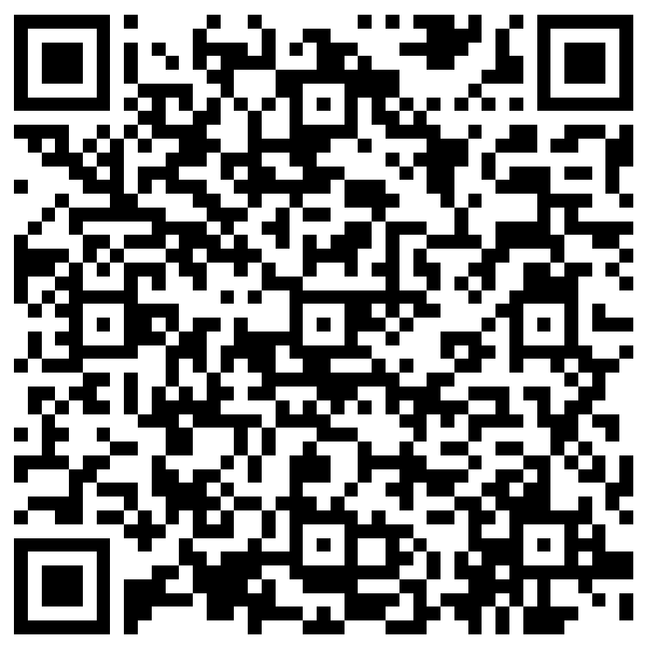
The next Zoom Liaisons Meeting will be held on
Thursday, May 18, 2023 (10:00a-11:00a)
Please let us know if there is a topic that you would like to hear about!
MS Forms: LINK HERE

Slide 19
Human Resource Management Contacts
Chief Human Resources Officer | Jill Fragoso | #3-2634
Employee Relations
Employee Relations Manager | Leila McConnell | #3-4947
Employee Relations Consultant | Carla Popularas | #3-5798
Employee Relations Consultant | Mike Jarvis | #3-1680
Compensation & Benefits
Compensation Manager | Sara Schexnayder | #3-4226
Benefits Manager | Beth Worthen | #3-8742
Benefits Consultant | Laurie Kirzner | #3-8741
Benefits Generalist (Leave Administrator) | Mark Gele | #3-7812
Benefits Consultant | Maddie Hopkins | #3-2455
Compensation Analyst | Kel Brownfield | #3-7378
Human Resource Information Systems (HRIS)
Assistant Director, HRIS | Michelle Sharp | #3-2029
HRIS Manager | Jane Behlen | #3-1616
File Room Coordinator | Janet Magee | #3-8158
Administrative Coordinator 3 | Michael Mosley | #3-4834
Human Resources Specialist | Myra Christophe | #3-1781
Talent Management
Talent Acquisition Manager | Shauna Caputo | #3-2047
Human Resources Specialist | Timethia Brown | #3-4835
HR Generalist | Cristina Guillory | #3-2044
HR Generalist | Alicia Rodriguez | #3-8740
HRM Talent Acquisition Coordinator | Tannia Jacob | #3-4832
Talent Development Manager | Denise Robinson | #3-1609
Learning & Development Trainer | Tranell Barton | #3-8640
HRM Talent Development Coordinator | Alexander-Quang Tran | #3-2214

