Slide 1
HRM Liaisons Meeting
January 20, 2022

Slide 2
Access Meeting Recording
Topic: HRM Liaisons Meeting - JANUARY 2022
Start Time: Jan 20, 2022 09:46 AM
Meeting Recording:
https://lsuhsc.zoom.us/rec/share/mapODFwfXinHy7xEyASsX9ubb6_E0g6WMJXemLhyQweuzU3Z53aV7tnDoC2hmB37.orIESLCQZQxabMc8
Access Passcode: HRMLiaisons2022!

Slide 3
AGENDA
HRM Updates HRM Staffing & Recruitment Update HRM Liaisons Partners and Information Sharing | Juli Sholar
Compensation 2022 Compensation Review Update | Sara Schexnayder
Benefits & Retirement Updated COVID Leave & Reporting Protocol | Kacy Smith
Talent Development 2022 Performance Success Conversations Unclassified Employees | Matt Copeland
Wrap-up

Slide 4
HRM General Updates
Juli Sholar, HRM Assistant Director Talent Management

Slide 5

HRM Talent Management
TalentDevelopment@lsuhsc.edu
HRM General Updates
HRM Staffing & Recruitment Updates
HRM Information Sharing

Slide 6
HRM Compensation
Sara Schexnayder, HRM Compensation Manager

Slide 7
HRM Compensation
HRMCompensation@lsuhsc.edu
Equity/Salary Review Update
Salary Structure
Salary structure will be updated, effective February 1
Employees below the new minimum will be brought to the new minimum when the structure changes.
  No other salary adjustments at this time
We will start using the new ranges in job postings and salary offers
Survey
94% Participation rate on survey
Analysis
Developed methodology to evaluate where adjustments are needed
We will share our recommendations by employee with the school financial leads and Deans
Financial leads will review the employees survey responses as well as our recommended ranges and make any adjustments needed.
Targeting equity increases for July 1.

Slide 8
HRM Benefits
Kacy Smith, HRM Benefits & Retirement Manager

Slide 9
HRM Benefits
NOHRMBenefits@lsuhsc.edu
Covid Leave & Reporting Protocol
Employees who experience potential moderate-to-high-risk exposure, possible symptoms, or receive positive test results should self-isolate
Potential moderate-to-high-risk exposure, possible symptoms, and positive test results should be reported to Campus Health immediately
Campus Health will determine the need for further self-isolation, contact tracing, and requirements for the employee to return to work
Employees will need to use their own sick and/or annual leave for any time they are unable to work
  Can also use sick leave if caring for a spouse, child, or parent who is exposed/symptomatic/positive
FMLA not needed for recommended quarantine period of 5-10 days
  If employee is out past quarantine period, reach out to HRMFMLA@lsuhsc.edu for FMLA determination.
More information:
Prevention and Management of COVID on the LSUHSC Campus

Slide 10
HRM Talent Development
Matt Copeland, HRM Talent Development Manager

Slide 11
HRM Talent Development
TalentDevelopment@lsuhsc.edu
2022 Unclassified Performance Evaluations
Updates in progress for Unclassified Employee Performance Evaluation Process
Includes revision of the form, reporting tool, and evaluative competencies.
Incorporates Perf Eval processes in place from LSUHSC, LSU Baton Rouge, and comparable institutions.
External to PeopleAdmin
March-April timeframe for conducting Performance Success Conversations
Committee in place representative of roles and interests across LSUHSC and HRM
Training resources and formal communications to follow
Questions and Feedback to HRM Talent Development
Notes:
HRM is supporting interests of Dr. Nelson through the update and streamline of the Performance Evaluation process. For the 2021-2022 year, classified employees will remain

Slide 12
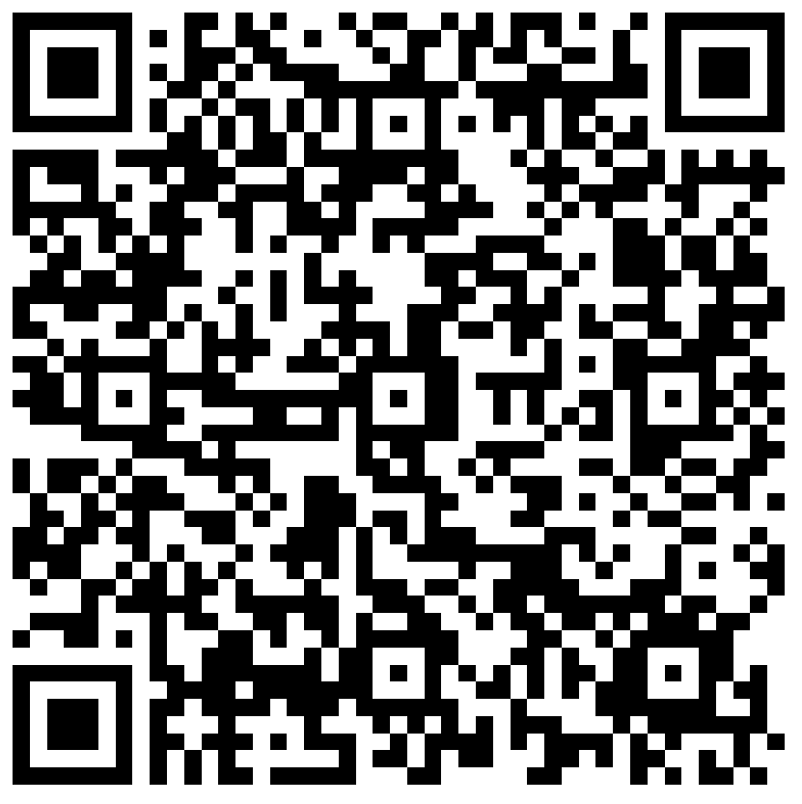
HRM Liaison Questionnaire
2022 Unclassified Performance Evaluation Process Update

Slide 13
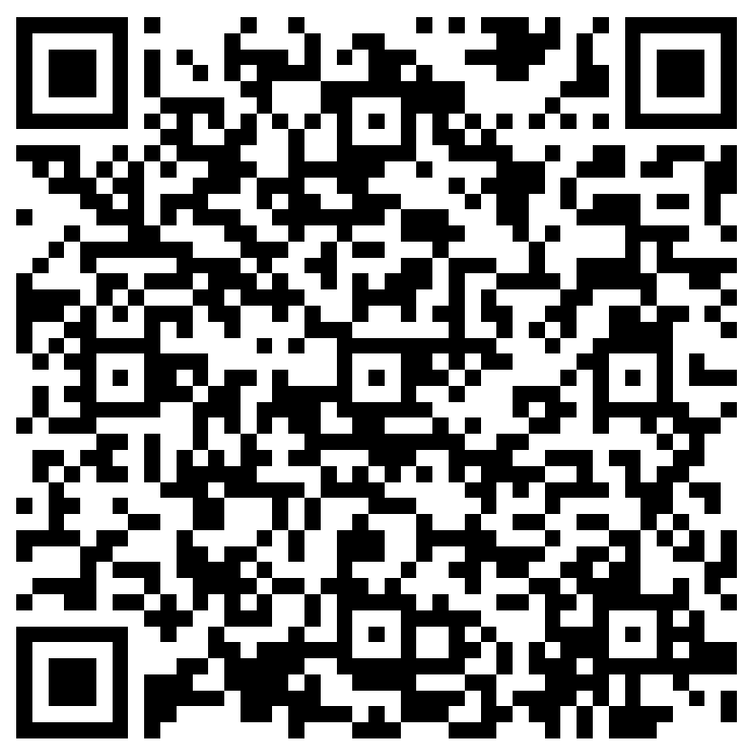
The next Zoom Liaisons Meeting will be held on
Thursday, February 17, 2022 (1000a-1100a)
Please let us know if there is a topic that you would like to hear about!
MS Forms: LINK HERE

Slide 14
HRM Department Contacts
Human Resource Management
Employee Relations
Employee Relations Consultant | Kentrella Crawford | #3-4947
Compensation & Benefits
Compensation Manager | Sara Schexnayder | #3-4226
Benefits & Retirement Manager | Kacy Smith | #3-8740
Benefits Consultant | Laurie Kirzner | #3-8741
Benefits Generalist (Leave Administrator) | Mark Gele | #3-7812
Benefits Specialist | Chakia Hebron | #3-2455
Compensation & Compliance Analyst | Maddie Hopkins | #3-7378
Human Resource Information Systems (HRIS)
Assistant Director, HRIS | Michelle Sharp | #3-2029
HRIS Manager | Jane Behlen | #3-1616
File Room Coordinator | Janet Magee | #3-8158
HRIS Administrative Coordinator | Dee Bonvillian | #3-4834
Talent Management
Assistant Director, Talent Management | Juli Sholar | #3-2954
Sr. Talent Acquisition Consultant | Shauna Caputo | #3-2047
HR Analyst | Timethia Brown | #3-4835
HR Analyst | Briana Williams | #3-4832
Talent Development Manager | Matt Copeland | #3-1609

Slide 15
Questions?

