Slide 1
June 23, 2022
HRM Liaisons Meeting
June 2022 Meeting

Slide 2
HRM General Updates
Juli Sholar, HRM Assistant Director Talent Management
Notes:
PM-20 and Staffing Updates. Welcome, Denise!!

Slide 3
HRM Talent Acquisition
Shauna Caputo, Talent Acquisition Manager

Slide 4
HRM Talent Acquisition recruittalent@lsuhsc.edu
Fiscal Year-End Budget Process
Fiscal year-end budget load is projected to process on the evening of July 12th
HRM is able to enter actions in PeopleSoft as normal for House Officers, Fellows/Interns, Student Workers, Gratis and Graduate Assistants
HRM is able to enter actions in PeopleSoft as normal for June (monthly payroll currently running)
Most Unclassified, Faculty and Classified actions for July and future dated actions will need to be held until the budget load process is complete (excluding new hires)
Please submit all PER-3 documents and new hire documents to HRM as soon as possible so that HRM can route for approvals and have cleared for entry as soon as we are able once fiscal year-end budget load process is complete

Slide 5
HRM Talent Acquisition recruittalent@lsuhsc.edu
Student Worker Packets
Please include:
PER-2
Student worker application
Biographical data form
Data Protection
Oath of affirmation
Complete I-9 with supporting documents in Hire Right (required for all paid employees)
Direct Deposit
W-4 and L-4
Verification of full time enrollment (if LSUHSC student, the student may print this out from their student portal)
Copy of signed social security card (for payroll verification purposes)
Once packet is approved, our team will advise department and confirm start date

Slide 6
HRM Compensation
Sara Schexnayder, HRM Compensation Manager

Slide 7
Compensation
HRM Compensation@lsuhsc.edu
Equity/Merit Review Update
Effective Date: 7-1-22
School financial leads received communication documents to be shared with impacted employee
Overall, 2% Equity and 3% merit are being distributed
Increases were loaded into the budget system

Slide 8
Compensation
HRM Compensation@lsuhsc.edu
Q&A’s on Increases
Who was eligible for equity and merit increases?
Faculty and unclassified staff were eligible for consideration for equity increases. In addition, eligibility for Merit increases required the employee be in a regular full-time position (at least 75% effort) as of September 1, 2021.
If I didn’t get an equity, does that mean LSUHSC believes I am compensated appropriately?
Not necessarily. With the limited budget, the equity increases were directed towards the areas with the greatest disparity.
What were the criteria to determine who got equity increases?
Factors considered included: current salary relative to external market rate for the job; salaries of others in the same position and level relative to experience in the job, experience in the function, total work experience, education, and relevant certifications; and scope of work relative to others in similar roles. As long as performance was at an acceptable level, it was not a factor in determining equity increases.

Slide 9
Compensation
HRM Compensation@lsuhsc.edu
Q&A’s continued
Was there a limit on the size of increases?
There was a cap of $7,500 on both the Merit and the Equity. In addition, the maximum percent for Equity was 12% of base and Merit was capped at 6%.
Will LSUHSC begin giving raises every year?
While the University’s plan is to award merits annually, we acknowledge we have to work within state budget constraints.
Why weren’t classified employees included?
Classified employees fall under Louisiana State Civil Service rules and policies. Classified employees will receive Market Adjustments July 15, 2022 as they do each year.
If I have questions about the process used for my department who do I contact?
The school financial leads can help with any questions on the process followed for your group.

Slide 10
HRM Talent Development
Alexander-Quang Tran, Talent Development Coordinator

Slide 11
Performance Evaluation System
HRM Talent Development
TalentDevelopment@lsuhsc.edu
Overview | Keep in Mind!
State-mandated performance evaluation process for our Classified Staff except employees considered “When Actually Employed” (WAE).
The PES will be completed using the Online Performance Evaluation Tool.
Newly appointed supervisors of classified staff are required to complete PES Training prior to conducting PES Evaluations and Plannings.
  If an employee needs to complete this training, please reach out to Talent Development at TalentDevelopment@lsuhsc.edu for more information.
LSU Performance Evaluation System Completion Deadline
  2021 - 2022 Evaluation: 8-8-2022
  2022 - 2023 Planning: 9-9-2022

Slide 12
PES Timeline
Annual Performance Cycle
HRM Talent Development
TalentDevelopment@lsuhsc.edu
Evaluation
2021-2022
July 1 – August 8, 2022
Planning
2022-2023
July 1 – September 9, 2022
July
Aug
Sept
Oct
Nov
Dec
Jan
Feb
Mar
Apr
May
June
July
Aug
Sept
Annual Performance Cycle 2022-2023
July 1, 2022– June 30, 2023
Collect performance documentation for evaluation
Evaluation
2022-2023
July 1 –
August 11, 2023
Planning
2023-2024
July 1 – September 8, 2023
Notes:
This timeline (relatively) depicts how evaluation or the previous year’s evaluation and the current year’s planning coincide.

Slide 13
Performance Evaluation System
The yearly performance cycle from planning to appraisal
HR PES Final Review
2
10
3
4
5
6
7
8
9
1
PES Plan Review
The Human Resources representative reviews the evaluation for accuracy.
Supervisor enters the employee’s work and behavior expectations in accordance with the guidelines of Louisiana State Civil Service.
Employee Acknowledges Evaluation Meeting
Second Level Approval of PES Plan
After the PES evaluation meeting has taken place, the Employee acknowledges.
The second level Supervisor reviews the plan for accuracy.
Supervisor Acknowledges Evaluation Review Meeting
PES
Supervisor Acknowledges Plan Review Meeting
After the PES evaluation meeting has taken place, the Supervisor acknowledges.
After the PES plan meeting has taken place, the Supervisor acknowledges.
Second Level Supervisor Approval
Employee Acknowledges PES Plan
After reviewing the Supervisor’s evaluation, the second level Supervisor approves.
After the planning meeting has taken place, the Employee acknowledges.
Supervisor Evaluation
HR Reviews PES Plan
At the end of the performance cycle, the Supervisor appraises the Employee.
The Human Resources representative reviews the plan for accuracy.
Notes:
Steps 1 - 5 are colored in blue. These are the steps that will be completed in the planning period.
Steps 6 - 10 are colored in red. These are the steps that will be completed in the performance evaluation period.

Slide 14
HRM Talent Development
TalentDevelopment@lsuhsc.edu
State Civil Service Classified Performance Evaluation System
Mark your Calendars!
DUE DATES:
2021 – 2022 PES EVALUATION: August 8, 2022
2022 – 2023 PES PLANNING: September 9, 2022

Slide 15
HRM Talent Development
TalentDevelopment@lsuhsc.edu
PES Milestones
Step |  | Suggested Dates
6 | Supervisor PES Evaluation | July 1 – July 8, 2022
7 | Second Level Approval | July 11 – July 15, 2022
8 | Supervisor Acknowledges Evaluation Meeting Occurred | July 18 – July 29, 2022
9 | Employee Acknowledges Evaluation | August 1 – August 8, 2022
10 | HRM Reviews and Approves
1 | Supervisor PES Plan Review | August 1 – August 8, 2022
2 | Second Level Supervisor Approval | August 9 – August 16, 2022
3 | Supervisor Acknowledges Planning Meeting Occurred | August 17 – August 31, 2022
4 | Employee Acknowledges PES Plan | September 1 – September 9, 2022
5 | HRM Reviews and Approves
2021-2022 PES
2022-2023 PES
Notes:
HRM suggests following these milestones to complete the various steps of the PES process in a timely manner, ensuring everyone has ample time to complete their PES steps and staying

Slide 16
HR Information Systems
Michelle Sharp, HRM Assistant Director of HRIS

Slide 17
Human Resource Information Systems
HRIS@lsuhsc.edu
C-Cure Badging System
  Unavailable due to House Officer Onboarding
    Monday, June 27th
    Tuesday, June 28th
  If a badge is a critical need during those days, please email HRMIDBadge@lsuhsc.edu and we will coordinate efforts to get a badge issued.

Slide 18
Human Resource Information Systems
HRIS@lsuhsc.edu
Gratis Employees
  3,044 active
  Longest employed = 69 years
  Over the age of 100 = 6
  Oldest gratis employee = 102
  If you wish to audit those active gratis employees within your department, email HRIS@lsuhsc.edu requesting a list.
  - A PER3 is required to terminate those who may longer need to have a gratis affiliation.

Slide 19
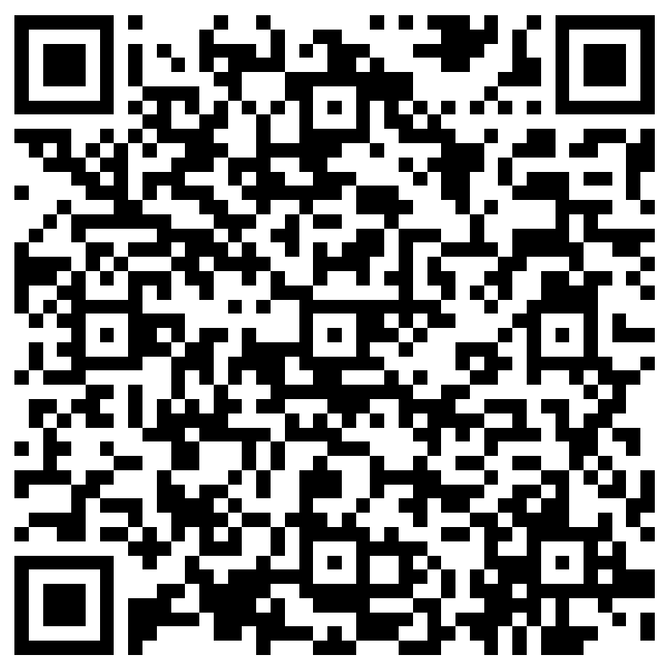
The next Zoom Liaisons Meeting will be held on
Thursday, July 21, 2022 (10:00a-11:00a) unless…
Please let us know if there is a topic that you would like to hear about!
MS Forms: LINK HERE

Slide 20
Human Resource Management Contacts
Employee Relations
Employee Relations Manager | Leila McConnell | #3-4947
Compensation & Benefits
Compensation Manager | Sara Schexnayder | #3-4226
Benefits & Retirement Manager | Kacy Smith | #3-8740
Benefits Consultant | Laurie Kirzner | #3-8741
Benefits Generalist (Leave Administrator) | Mark Gele | #3-7812
Benefits Specialist | Vacant
Compensation & Compliance Analyst | Maddie Hopkins | #3-7378
Benefits Analyst | Kel Brownfield | #3-7780
Human Resource Information Systems (HRIS)
Assistant Director, HRIS | Michelle Sharp | #3-2029
HRIS Manager | Jane Behlen | #3-1616
File Room Coordinator | Janet Magee | #3-8158
HRIS Administrative Coordinator | Dee Bonvillian | #3-4834
Talent Management
Assistant Director, Talent Management | Juli Sholar | #3-2954
Talent Acquisition Manager | Shauna Caputo | #3-2047
HR Analyst | Timethia Brown | #3-4835
HR Generalist | Aminah Moody | #3-4832
HR Generalist | Cristina Guillory | #3-2044
Talent Development Manager | Vacant | #3-1609
HRM/Talent Development Coordinator | Alexander-Quang Tran | #3-2214

Slide 21
Questions?

