Slide 1
HRM Liaisons Meeting
January 2023 Meeting

Slide 2
HRM Updates
Denise D. Robinson, Talent Development Manager

Slide 3
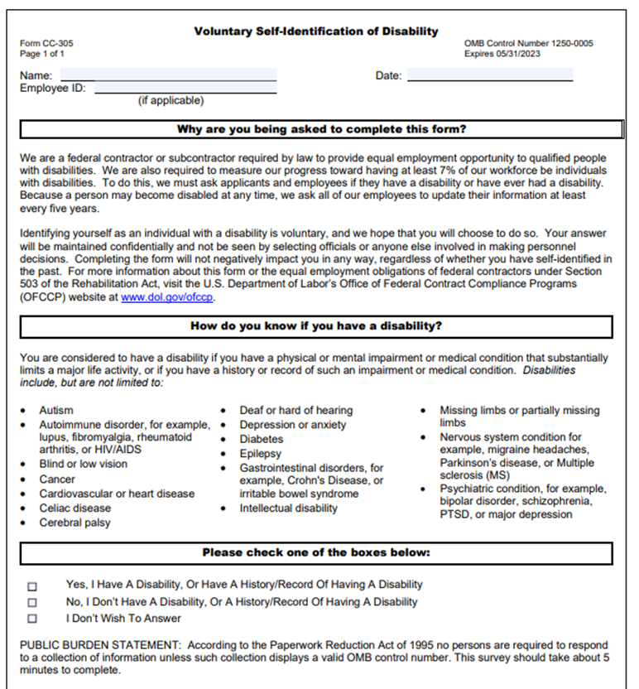
Human Resource Management
nohrm@lsuhsc.edu
Friendly Reminder
    Act 103 of the 2022 Regular Session establishes certain policy, training and reporting requirements for all executive branch state agencies for purposes of compliance with the Americans with Disabilities Act (ADA). It promotes affirmative strategies and goals for employment of individuals with disabilities through development and submission of annual State As a Model Employer (SAME) plan.
    What does this mean for our employees?
    Required Training for all Supervisors and agency ADA coordinators
    Must be complete by November 13, 2022, currently in your KDS portal
      Current response rate is approximately 73%
    New supervisors will be required to complete within 90 days of employment or supervisor position
    Training will be required every 3 years
    Completion of Voluntary Self-Identification of Disability Form for all employees
    Must be complete by September 30, 2022 to ensure compliance with La. R.S. 46:2597(1)
      Current response rate is approximately 35%
    All new employees complete this disclosure as part of their new hire packet
    Required to complete every 5 years
PeopleSoft self-service (Main Menu> Self-Service> Personal Information> Disability
Office of Human Resource Management> Forms> Voluntary Self Identification of Disability
Notes:
DR script:
We’d like to remind you of some training and reporting requirements that apply to our state agency.
*Supervisors and ADA coordinators are required to complete ADA-related training by November 13, 2022. Currently, in the KDS portal, we are about 73% compliant.
New supervisors are required to complete within 90 days of employment or promotion to a supervisory position.
This Training is required every 3 years.
*Also, every employee must complete the Voluntary Self-Identification of Disability form. This should be completed by September 30, 2022. Our current response rate is 35%.
All new employees complete this disclosure during the onboarding process.
This is required every 5 years.
At the bottom of the screen, we have the menu path to complete this disclosure electronically.

Slide 4
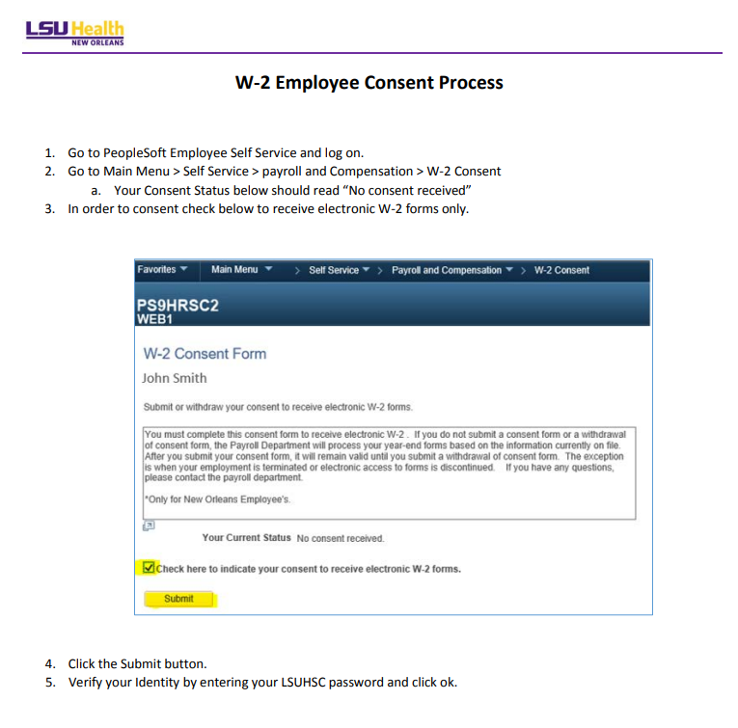
Human Resource Management
nohrm@lsuhsc.edu
Friendly Reminder

Slide 5
HRM Employee Relations
Leila McConnell, Employee Relations Manager

Slide 6

EMPLOYEE RELATIONS
Employee Relations
nohrmlabrel@lsuhsc.edu
EMPLOYEE RELATIONS

Slide 7
HR Information Systems
Michelle Sharp, HRM Assistant Director of HRIS

Slide 8
Human Resource Information Systems
HRIS@lsuhsc.edu
Monthly Certification Reminders
Monthly certifications are available to employees on the 5th of the month, to certify time for the prior month.
Employees should certify their time before the supervisor completes the certification.
  Supervisors should be viewing the Leave Detail data within the certification to confirm there are no outstanding time requests needing action
  PeopleSoft> Main Menu> Manager Self Service> Certification (Supervisor)
If the employee is not available to submit their certification, the supervisor will be prompted to select a reason when they submit the certification, and should enter a note with details, as necessary.
Only the current supervisor will be able to take action on certifications. This is important because once a supervisor change is entered, the prior supervisor will no longer be able to enter a certification.
HRM does have a process when a new supervisor is entered to verify that there are no outstanding certifications entered. If there are, we will reach out to request action prior to making the update.

Slide 9
Human Resource Information Systems
HRIS@lsuhsc.edu
SF-6 Request Reminders
SF-6 requests route to the supervisor that is listed on an employee’s position data.
Supervisors should stay up-to-date on current requests. You can easily view the month’s approved requests when you certify your employees time to ensure that it accurately reflects leave usage.
PeopleSoft> Main Menu> Manager Self Service> Absence> Absence Approval (SF-6)
Including the Pending My Approval checkbox and search
Supervisors cannot approve pending requests after an employee has terminated employment. Our office performs an audit of leave balances in order to ensure an accurate payout, so we do verify that pending requests are reviewed.
When a supervisor change is entered into PeopleSoft any pending requests will no longer be actionable by the former supervisor. Our office does check for pending requests prior to keying a supervisor change, and we will reach out for assistance as necessary. Future-dated pending requests get rerouted to the new supervisor for action.
ZZ_SF6_QUERY_BY_DEPARTMENT is a query for business managers to look at outstanding requests.

Slide 10
HRM Benefits
Beth Worthen, Benefits & Retirement Manager

Slide 11
HRM Benefits
nohrmbenefits@lsuhsc.edu
2022 Tax Information
Electronic Form 1095-C
All employees can receive their 1095-C electronically. In order to receive an electronic copy of your 1095-C, you must complete the 1095-C Consent Form through Employee Self-Service.
Main Menu, follow the path: Self Service | Benefits | 1095-C Consent.
If you have previously consented to receive an electronic 1095-C, you do not have to do so again. Once the Consent Form is submitted, it will remain valid until you submit a Withdrawal of Consent Form unless your employment is terminated.
If you prefer to receive a paper 1095-C, you must submit a Withdrawal of Consent Form within Self-Service.

Slide 12
HRM Benefits
nohrmbenefits@lsuhsc.edu
Benefits of opting into electronic delivery:
Earlier access to the 1095-C forms than paper copies.
No possibility for a lost, stolen, delayed or misplaced Forms.
The 1095-C is accessed via PeopleSoft Employee Self Service securely using the employee's credentials (User name and Password) at any time of the day and on weekends.
Only need to consent one time as consent carries over each year while actively employed.
Employees have the option to print multiple copies at their convenience.
Less paper contributes to an environmentally responsible campus.

Slide 13
HRM Benefits
nohrmbenefits@lsuhsc.edu
Supplemental Retirement Accounts
The IRS approved Cost of Living Adjustments for the 2023 tax year. The contribution maximums for the 403(b), Roth 403(b), 457(b), and Roth 457(b) supplemental retirement accounts for 2023 are increasing to:
$22,500 for participants under the age of 50
$30,000 for participants age 50 and older
Information about each plan as well as enrollment and/or contribution change instructions can be found on our website.

Slide 14
HRM Benefits
nohrmbenefits@lsuhsc.edu
Supplemental Retirement Accounts
403(b) and Roth 403(b) Plans
Visit www.MyRetirementManager.com to register, choose your paycheck contribution amount and select your vendor.
Retirement Manager Instructions
Contact info for vendors can be found here.
457(b) and Roth 457(b) Plans
Current participants can make deferral changes online at Louisiana Public Employees Deferred Compensation Plan website.
Empower Instructions
Empower Contact: WILL PARRIE @ (504) 247-5996 or Will.parrie@empower-retirement.com

Slide 15
HRM Benefits
nohrmbenefits@lsuhsc.edu
Pet Insurance
Louisiana State University is pleased to announce that it has partnered with MetLife to offer Pet Insurance to the LSU Community starting January 1, 2023.
Flexible product offerings with straightforward pricing options and customizable limits
Deductible savings—your pet’s deductible decreases if you go claim-free in a policy year
Quick 3-step enrollment and hassle-free claims experience— most claims are processed within 10 days
Multi-channel support options—caring and passionate pet advocates who have been serving pet parents and their communities for more than 15 years
Information on how to enroll or get a quote will be distributed soon. Please review more information on our website under Other Benefits.

Slide 16
HRM Talent Acquisition
Shauna Caputo, Talent Acquisition Manager

Slide 17
HRM Talent Acquisition
recruittalent@lsuhsc.edu
I-9/E-verify
Hire Right I-9/E-verify User Guide
All paid employees should have I-9/e-verify completed in Hire Right
Gratis employees I-9 should be completed via paper (see for current version/acceptable documents)
  https://www.uscis.gov/sites/default/files/document/forms/i-9-paper-version.pdf
I-9 should be initiated after criminal background check and drug test (if applicable) are completed

Slide 18
HRM Talent Acquisition
recruittalent@lsuhsc.edu
I-9 Compliance Notes:
Start date must match the actual start date of employee
  NOTE: When initiating I-9, the start date can be left blank and filled in when certifying in order to reduce need to make I-9 correction at later date
Page one must be completed by employee no later than first day of employment
Page three must be certified by employer no later than third business day after start
Acceptable original I-9 documents must be viewed/verified and uploaded as supporting documents in Hire Right by employer (these documents should not be included in new Hire packet)
  NOTE: If uploading B & C documents this can be selected in Hire Right when uploading supporting and uploaded as one document – department is charged per upload

Slide 19
HRM Talent Development
Denise D. Robinson, Talent Development Manager

Slide 20
HRM Talent Development talentdevelopment@lsuhsc.edu
Performance Evaluations for Unclassified Staff & Faculty
Submission Portal Opens February 1st, 2023
Submission Deadline is March 15th, 2023
Evaluations are used to inform decisions on compensation changes
For new employees with a hire date on or after October 2nd, 2022, no evaluation is required.
For new employees with a hire date on or before October 1st, 2022, an evaluation must be submitted.
Staff & Faculty will be evaluated for the performance period beginning on 4/1 through 12/31.

Slide 21

Performance Evaluations
The 4-Step Process Overview
Staff Evaluation Form Faculty Supplemental Rating Form
DOWNLOAD
Access the form on the HRM Talent Development Webpage and available in your training handouts.
EVALUATE
Complete the form in Adobe Acrobat ONLY.
MEET
Meet with the employee for the Performance Conversation.
SUBMIT
Download and Save to your computer.
Open in Adobe Acrobat ONLY.
Distribute to staff for self-evaluations. Inform employees that self-evaluations are highly encouraged components of the evaluation process.
Comment Section
MUST be completed for ratings greater or less than "3". Strongly encouraged for Job-Specific criteria.
Feedback is provided to the employee in a clear and direct fashion with actionable guidance.
Employee and evaluator(s) may sign the form physically or electronically.
Scan the completed form(s) and save to your computer.
2nd-Level approver e-signs if rated "Outstanding" or "Unsatisfactory"
Best Practice
Be sure to use objective measures when evaluating performance. Objectivity is difficult but essential to an equitable evaluation process.
Discuss employee's self-evaluation and supervisor's evaluation of employee.
Submit the evaluation, and, if applicable, self-evaluation and/or planning letter via the Evaluation Submission Portal (linked below and in the Resources section).

Slide 22
Performance Evaluations
Completing the Faculty Supplemental Rating Form
Which Form Do I Use?
You can download the review form from your school’s LSUHSC Webpage if it is made available on the site. Please contact your school leadership for the most up-to-date review form.
School | Forms
School of Medicine | SOM Annual Faculty Review & HRM Faculty Evaluation Supplemental Rating Form
School of Dentistry | Please refer to your school/department leadership. SOD is in the process of developing a revised Annual Review Form, which is expected to incorporate a rating scale.
School of Nursing | School of Nursing Annual Faculty Review Form
School of Allied Health Professionals | HRM Faculty Evaluation Supplemental Rating Form and Planning Letter
School of Public Health | School of Public Health Annual Faculty Review Form
HRM provides general guidance but does not develop or manage the faculty evaluation process for each school.

Slide 23
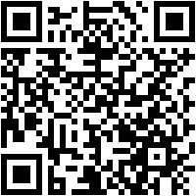
HRM Talent Development talentdevelopment@lsuhsc.edu
Performance Evaluations Manager Training Sessions
REGISTER HERE
Zoomers https://lsuh.sc/23PEVM
In-Person https://lsuh.sc/23PEIP
Upcoming Training Dates
January 20th 10 AM – 11:15 AM (ZOOM)
January 23rd 10 AM – 11:15 AM (ZOOM)
January 26th 10 AM – 11:15 AM (HYBRID)
TD Evaluations Resource Page
https://lsuh.sc/performanceeval2023-info

Slide 24
HRM Talent Development talentdevelopment@lsuhsc.edu
Supervisor Training Series
Talent Development is currently developing a comprehensive Supervisor Training Series to support supervisors and department trainers in understanding and properly executing various processes they will need to conduct in their supervisory role that may require training/guidance.
Coming this Spring
FMLA for Supervisors
ADA-Supporting Members with Disabilities
I-9s
Upcoming
LWOP for Supervisors
Workplace Discrimination for Supervisors
Workplace Harassment for Supervisors
And additional topics: PeopleAdmin, Managing Performance, Workplace Complaints

Slide 25
Human Resource Management
nohrm@lsuhsc.edu
February 14 – 9:00 am
PeopleAdmin Position Management and Applicant Tracking Training
Basic Navigation and Functionality
Intended for new users
Invitations will be sent to the HR Liaison list to sign up and pass along to others in your group. You may also register for the session with the link provided below:
https://www.supersaas.com/schedule/LSUHSC_Human_Resources/PeopleAdmin_Position_Mgmt
If there are others who you believe should be invited, please send their names to nohrmcompensation@lsuhsc.edu

Slide 26
Questions?

Slide 27
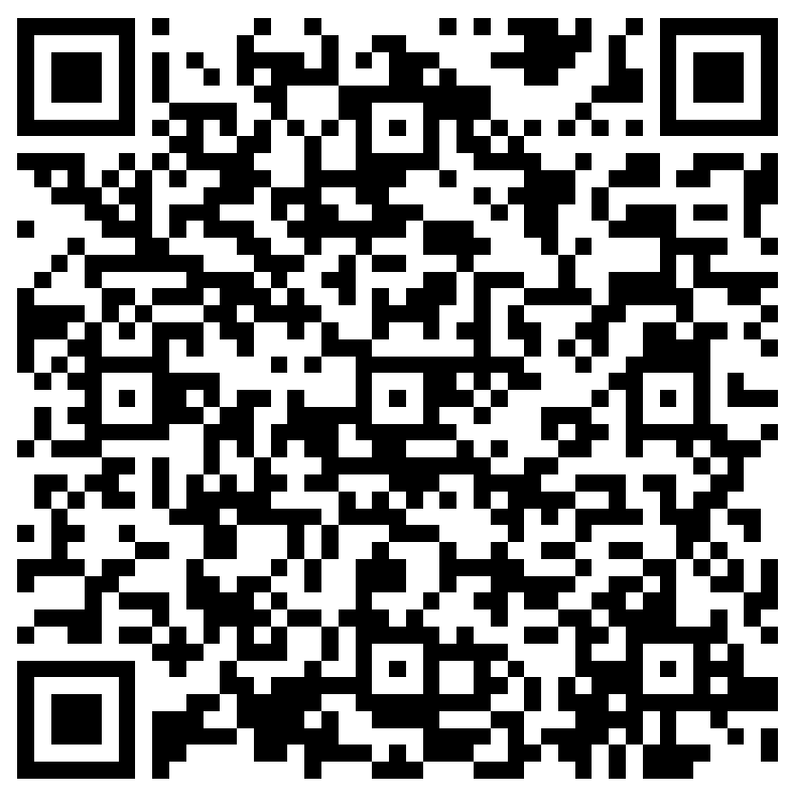
The next Zoom Liaisons Meeting will be held on
Thursday, February 16, 2023 (10:00a-11:00a)
Please let us know if there is a topic that you would like to hear about!
MS Forms: LINK HERE

Slide 28
Human Resource Management Contacts
Employee Relations
Employee Relations Manager | Leila McConnell | #3-4947
Employee Relations Consultant | Carla Popularas | #3-5798
Compensation & Benefits
Compensation Manager | Sara Schexnayder | #3-4226
Benefits Manager | Beth Worthen | #3-8742
Benefits Consultant | Laurie Kirzner | #3-8741
Benefits Generalist (Leave Administrator) | Mark Gele | #3-7812
Benefits Consultant | Maddie Hopkins | #3-2455
Compensation & Compliance Analyst | Kel Brownfield | #3-7378
Human Resource Information Systems (HRIS)
Assistant Director, HRIS | Michelle Sharp | #3-2029
HRIS Manager | Jane Behlen | #3-1616
File Room Coordinator | Janet Magee | #3-8158
Talent Management
Talent Acquisition Manager | Shauna Caputo | #3-2047
HR Analyst | Timethia Brown | #3-4835
HR Generalist | Cristina Guillory | #3-2044
HRM Talent Acquisition Coordinator | Tannia Jacob | #3-4832
Talent Development Manager | Denise Robinson | #3-1609
Learning & Development Trainer | Tranell Barton | #3-8640
HRM Talent Development Coordinator | Alexander-Quang Tran | #3-2214

