Slide 1
Welcome Liaisons!
January 2020 Meeting

Slide 2
AGENDA
Compensation/Talent Acquisition
PeopleAdmin ATS & E-Verify Updates
FAQ’s document
HRIS
LWOP Submission Reminder
Talent Development
Training Updates
PeopleAdmin PMP 2019 Reminders & 2020 Changes
What do you think?

Slide 3
Compensation
&
Talent Acquisition

Slide 4
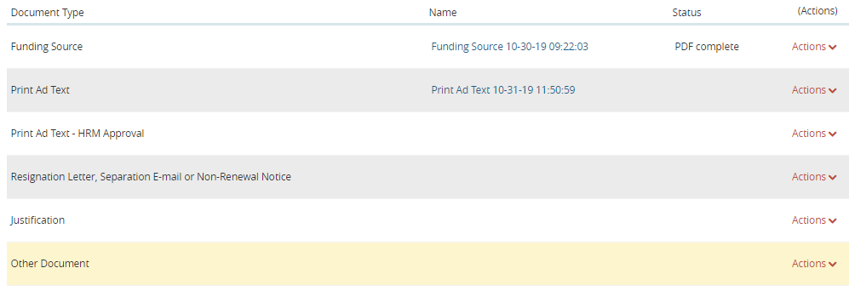
ATS
ATS Posting Documents

Slide 5
ATS
ATS Posting Documents
Funding Source – Template – PER-1
Print Ad Text – From School or Department
Print Ad Text – HRM Approval (For HRM Use Only)
Resignation/Separation E-mail/Non-Renewal Notice
Justification – For replacing or addition to staff (Faculty)
Other Document – Additional Document(s) pertaining to the need or support of the position and/or posting

Slide 6
ATS
ATS Posting Notes
Closing Open Until Filled Postings – Must be done by HRM
E-mail recruittalent@lsuhsc.edu to close the posting
Once we get a Hiring Proposal, we will close it (if applicable)
Dispositioning Candidate
DO NOT put candidate(s) in a final disposition until the finalist is Hired
Attachments
Can only be modified by the user that added the attachment

Slide 7
ATS
Hiring Proposals
Once the Applicant Reviewer Recommends an Applicant for Hire, the Initiator or Department Approver must submit a Hiring Proposal
To assist with this, we created a site trigger notification that will be sent to the Initiator and/or the Department Approver
Hiring Proposal Funding Sheet and Offer Letter
Work with your Dean’s Office (Schools) or Director (Divisions) for the best time or method for completing these documents and loading them into the Hiring Proposal

Slide 8
HireRight
Criminal Background Check (CBC)
DO NOT request a CBC on a new hire that has not been approved by HRM (PER-1 required positions)
Gratis New Hires – DO NOT request a CBC
Only send a request for a CBC, if the employee is being hired into a paid position outside of PeopleAdmin
Student Workers/Graduate Assistants/Interns/Trainee Fellows
Old ATS hires
All paid classifications that do not require a posting due to percent of effort less than 75%

Slide 9
HireRight
E-Verify
TODAY – Thursday, January 30th @ 1:30 PM
Join Zoom Meeting​
https://lsuhsc.zoom.us/j/163452517​
​
Meeting ID: 163 452 517​
​
Dial by your location​
+1 646 558 8656 US
+1 669 900 9128 US
​

Slide 10
HRM
Frequently Asked Questions (FAQs)
People Admin – General & Access
PeopleAdmin – Security
PeopleAdmin – Position Management
PeopleAdmin – Applicant Tracking System (ATS)
PeopleAdmin – Performance Management Program (PMP)
HireRight – Criminal Background Checks
HireRight – I-9/E-Verify
HR Resources (PeopleAdmin) - https://www.lsuhsc.edu/administration/hrm/hr_resources.aspx

Slide 11
HRIS

Slide 12
HRIS
Reminders
Timely LWOP Notification
Send initial email as soon as you become aware of the LWOP information to include projected dates
Send follow-up email letting us know when the employee has returned to work (often times the actual return date varies from the projected return date)

Slide 13
HRIS
Reminders
Timely LWOP Notification (HRMLWOP@lsuhsc.edu)
Employee Name (no nicknames)
EMPLID
Job Title
Work Schedule (minimally number of hours/day)
LWOP Date(s)

Slide 14
Talent Development

Slide 15
Talent Development
Training Updates
Leadership Series: Session Two: Communication
1/15 – 2/5
Still can register
Email TalentDevelopment@lsuhsc.edu for registration link
Leadership Series: Session One: Trust
Trained 244
Thursday, 2/20 morning session
Email TalentDevelopment@lsuhsc.edu for registration link

Slide 16
Talent Development
PA PMP Updates
Technical Issues
Changes in supervisory status
Faculty mistakenly in PMP
2020 delayed activation
Status of Campus
48.27% completed self-assessment
9.97% completed the supervisor evaluation
20.7% have not started the process

Slide 17
Talent Development
PA PMP 2020 Changes
Simplified step instructions
Employees will enter the plan
Supervisor approves or returns the plan
Simplified goals section
Simplified development plan section
Employee certifies understanding of competencies
Lengthened timeframe for employee to complete the self-assessment
Adjusted timeframe for supervisor to perform the evaluation
Let’s look at the infographics

Slide 18
What do you think?
Poll

Slide 19
Next Liaisons Meeting
February 27th

