Slide 1
Welcome Liaisons!
May 2020 Meeting

Slide 2
AGENDA
Talent Management – Cori Higginson
Benefits & Compensation – Peter Lloyd
Talent Acquisition & Operations – Nicole Kellum
Survey – Samantha Puszczewicz

Slide 3
Talent Management

Slide 4
Return to Campus
Special Leave
Documentation
Physician’s Documentation
Special Leave Provision Ending
Exceptions for certain situations
Partnering with legal – more to come
Return to Work Instructions from ER Department
Reach out with any questions to Cori
See this month’s HRM Guidance for details

Slide 5
Benefits & Compensation

Slide 6
Update on COVID-19 Leave Usage
Effective | Not at work situation | Leave
5/20/2020 | to care for himself due to a positive diagnosis of COVID-19 | Use Sick Leave, Annual Leave, Special Leave through 5/30
5/20/2020 | has a high-risk immunological disorders and needs to avoid exposure to COVID-19 to care for a spouse, domestic partner or dependent child residing in his household who has been positively diagnosed with COVID-19 needs to care for a spouse/domestic partner, or dependent child that has a high-risk immunological disorder(s) and needs to avoid exposure to COVID-19 | Use Annual Leave then Special Leave through 5/30
5/31/2020 | to care for himself due to a positive diagnosis of COVID-19 possible exposure to COVID-19 and has been advised by a healthcare provider to self-quarantine related to COVID-19, or who is experiencing COVID-19 symptoms and is seeking medical diagnosis | Use Sick Leave, then Annual Leave, then Special Leave will be granted for up to 15 working days, then Leave Without Pay
Note: Effective 5/20/2020, Sick Leave is no longer permitted for any reason other than the employee’s illness, injury or medical, dental or optical appointment.
See this month’s HRM Guidance for details

Slide 7
Benefits
Monthly Payroll
Effective December 2021, the December paycheck will be issued in December 2021 rather than January 2022
See this month’s HRM Guidance for details

Slide 8
Talent Acquisition & Operations

Slide 9
Process Improvement
Electronic PER-3 Termination
The automation went live May 15th!
Tips and things to remember
Additional instructions
See this month’s HRM Guidance for details

Slide 10
Questions, Comments, Concerns?

Slide 11
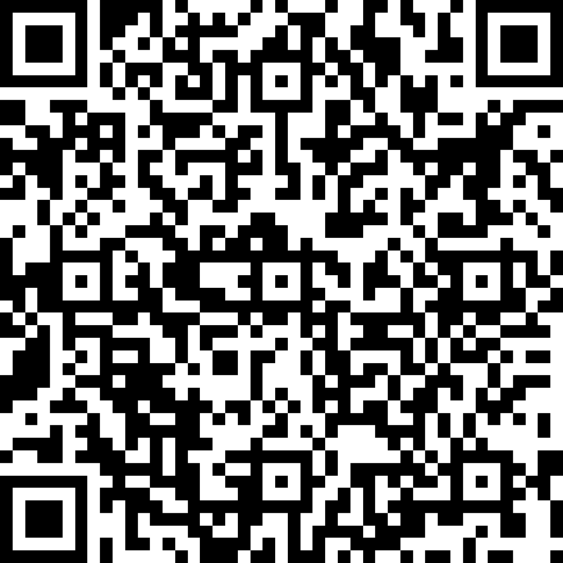
Thank you!
Anonymous Liaisons Survey
Next Liaison Meeting
June 25th
via Zoom
Focus your smart phone camera on the code above to open the survey

