Slide 1
HRM Liaisons Meeting
May 2023 Meeting

Slide 2
Employee Relations
Leila McConnell, Employee Relations Manager

Slide 3
Employee Relations nohrmlabrel@lsuhsc.edu
Quick Reminder
When your department is moving to Involuntary Termination, please remember to reach out to Employee Relations prior to communication with the employee.
We want to ensure you have all the information and support that you will need, make sure all the proper documentation is in place, and it gives us a heads up on the front end.
We are here to assist you with these difficult and delicate conversations.
Employee Relations Team
Carla Popularas
Employee Relations Consultant
504-568-5798
Mike Jarvis
Employee Relations Consultant
504-568-1680

Slide 4
HRM Benefits
Beth Worthen, Benefits & Retirement Manager

Slide 5
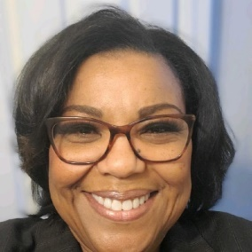


HRM Benefits
nohrmbenefits@lsuhsc.edu
New Benefits Team Members
Terry Varnado, PHR
Benefits Consultant
tvarn2@lsuhsc.edu
504-568-2799
Krystal Citty, aPHR
Benefits Coordinator
kcitty@lsuhsc.edu
504-568-7780

Slide 6
HRM Benefits
nohrmbenefits@lsuhsc.edu
Financial Wellness Seminar and
Financial Wellness 360 for State of Louisiana Employees
This seminar will cover important topics such as:
How to fund retirement
Understanding and addressing retirement challenges
How to navigate market uncertainty
Thursday – May 25, 2023 from 2:00 – 3:00 p.m. (CST)
via WebEx
Click Here to Register

Slide 7

HRM Benefits
nohrmbenefits@lsuhsc.edu
457(b) Supplemental Retirement
Will Parrie with Empower will be scheduling sessions on June 14, 2023.
Location: Study Room 3110 (across from the MEB cafeteria).
To schedule a meeting go to Will Parrie Booking Site or call 504-247-5996.
More information regarding supplemental retirement benefits can be found at: https://www.lsuhsc.edu/administration/hrm/supplemental_retirement.aspx

Slide 8

HRM Benefits
nohrmbenefits@lsuhsc.edu
403(b) Supplemental Retirement
Ronald Rodriguez with Corebridge.
Virtual presentations on May 25, 2023 from 9:00-11:00am.
Register Now to attend. Use code LSUPWA11AB
More information regarding supplemental retirement benefits can be found at: https://www.lsuhsc.edu/administration/hrm/supplemental_retirement.aspx

Slide 9

HRM Benefits
nohrmbenefits@lsuhsc.edu
403(b) Supplemental Retirement
Louis Bundy with TIAA will be scheduling sessions on May 30, 2023.
Location: Study Room 3108 (across from the MEB cafeteria).
To schedule a meeting contact louis.bundy@tiaa.org.
More information regarding supplemental retirement benefits can be found at: https://www.lsuhsc.edu/administration/hrm/supplemental_retirement.aspx

Slide 10
HRM Talent Acquisition
Shauna Caputo, Talent Acquisition Manager

Slide 11
HRM Talent Acquisition
recruittalent@lsuhsc.edu
Student Worker Updates
Eligibility:
At least part-time student in good standing; enrolled in an accredited high school, junior college, college or university, or a vocational-technical school.
Site to review for student worker applications:
Applicant Tracking Administration (lsuhsc.edu)
Applicant Tracking Administration (lsuhsc.edu)/916 - posting to view historical applicants up until 4/28/2023
Applicant Tracking Administration (lsuhsc.edu)/4075 - posting to view applicants as of 4/28/2023
Please email recruittalent@lsuhsc.edu if assistance is required:
to be added as initiator to create your own department specific student worker posting
to be added as applicant reviewer to generic student worker posting (4075)

Slide 12
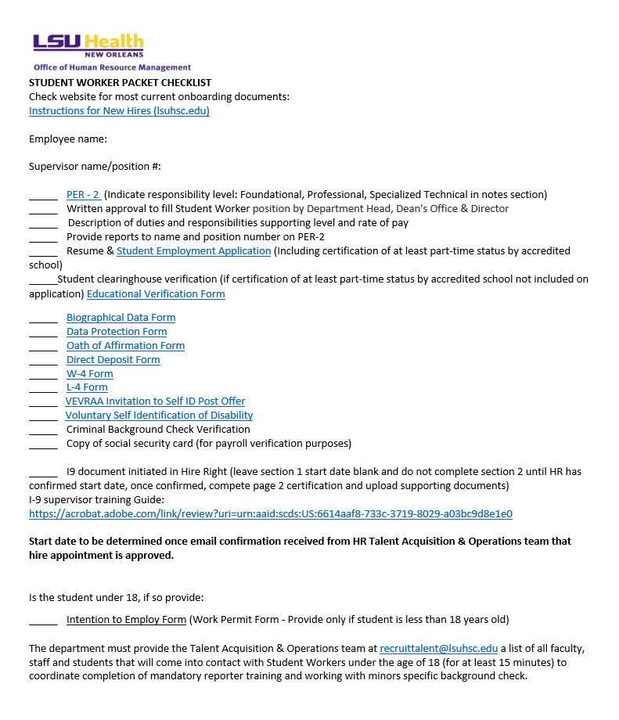
HRM Talent Acquisition
recruittalent@lsuhsc.edu
Student Worker Updates
Updated Checklist:

Slide 13
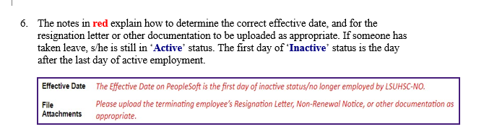
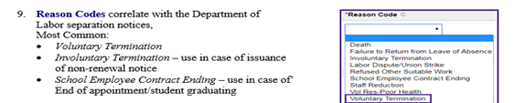
HRM Talent Acquisition
recruittalent@lsuhsc.edu
Student Worker Termination Process
Complete paid student worker termination via electronic system
Job aid and brief instructional video can be found on our website and via this link:
Electronic Terminations (lsuhsc.edu)
Effective date: Please use date immediately after last date of time punch on timesheet and upload supporting document or include notes in reason/justification box
Reason codes:
Voluntary – student resigns
School/Employee Contract Ending – student graduated

Slide 14
HRM Talent Acquisition
recruittalent@lsuhsc.edu
I-9 Training Guide
I-9 Supervisor Training Guide:
https://acrobat.adobe.com/link/review?uri=urn:aaid:scds:US:6614aaf8-733c-3719-8029-a03bc9d8e1e0
Highlights:
How the background check process should be initiated/completed prior to initiating an I-9
How to gain access to Hire Right/have account re-activated
Timeline for when each section of I-9 needs to be completed to remain compliant with federal guidelines
How to send employee I-9 invitation to complete page 1
How to complete employer page 2 certification process
Viewing original I-9 documents and what are acceptable I-9 documents
How to upload acceptable I-9 supporting documents
Helpful hints on how to avoid common mistakes
How to make corrections when needed
How to monitor your I-9 documents via manage I-9 tab
Re-verification process

Slide 15
HR Information Systems
Jane Behlen, HRIS Manager

Slide 16
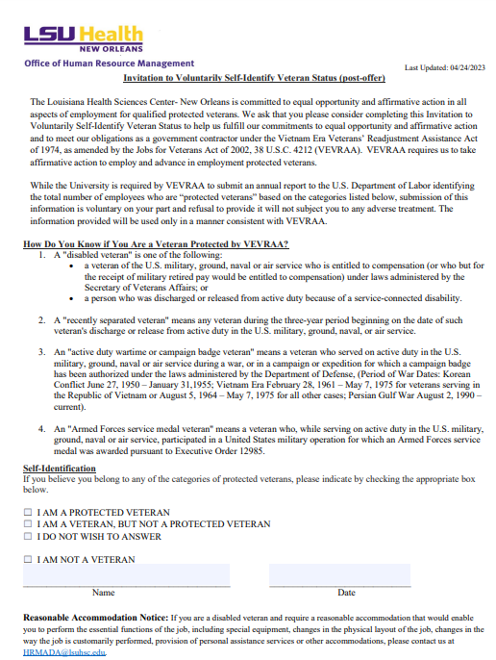
Human Resource
Information Systems
HRIS@lsuhsc.edu
Invitation to Voluntarily Self-Identify Veteran Status (post-offer)
Required under VEVRAA (Vietnam Era Veterans’ Readjustment Assistance Act) to submit an annual report to the U.S. Department of Labor identifying the total number of employees who are “protected” veterans.
Form previously two pages that included protected veteran status and disabled veteran accommodations.
  Updated 04/24/2023
  One page form
  Capturing veteran status
Current response rate of 57.7%
  PeopleSoft> Self Service> Personal Information> Veteran Status
Form can be found in our form's library on the HRM website https://www.lsuhsc.edu/administration/hrm/forms.aspx

Slide 17
Human Resource
Information Systems
HRIS@lsuhsc.edu
ID Badges
The Office of Human Resource Management will be unable to issue badges in Suite 603 on Monday, June 26th and Tuesday, June 27th , due to Resident Orientation.
If you have a concern with this blackout period, please email HRMidbadge@lsuhsc.edu to discuss additional options.

Slide 18
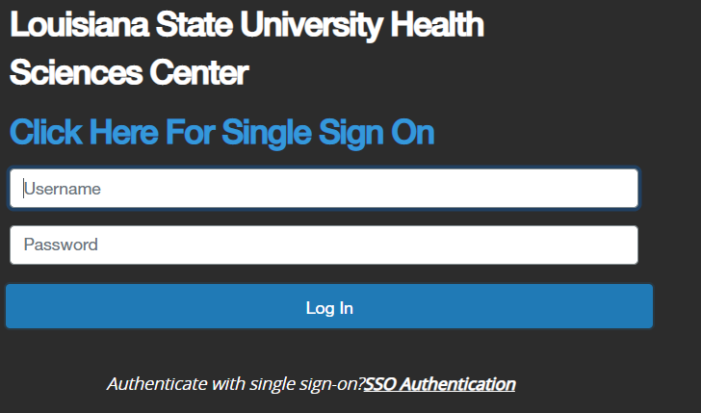
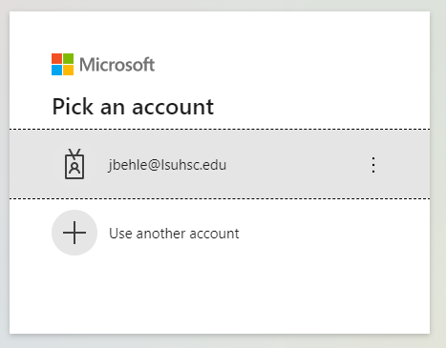
Human Resource
Information Systems
HRIS@lsuhsc.edu
Enhanced People Admin Security
Why are we doing this?
This enhancement aligns People Admin to our enhanced security strategy.
What will change?
The sign-in process to People Admin will change. When you access the site, instead of entering your username and password, you will instead select the SSO Link, which will route you to the familiar authentication process.
Users can no longer enter a username and password to log in. They will only be able to log in using the Single Sign on links.
The URL to access People Admin will change. We will update our links on the HRM website when we go live.

Slide 19
Human Resource
Information Systems
HRIS@lsuhsc.edu
Enhanced People Admin Security
When are we doing this?
The enhanced single sign on process will go live Tuesday, May 23, 2023.
What action is required for users:
Users who use favorites to access People Admin will need to update to the new URL.
No longer enter your username or password into the log in page.
Log in using the SSO links.

Slide 20
Talent Development
Dr. Tranell E. Barton, Talent Development Consultant/Trainer

Slide 21
Talent Development talentdevelopment@lsuhsc.edu
Performance Evaluation System (PES)
The process for evaluating classified employees (excluding WAEs)
“Chapter 18 is to be in effect during a transition period from July 1, 2023 through December 31, 2023, as the department transitions from the current paper-based Performance Evaluation System (PES) to Continuous Performance Management (CPM) effective January 1, 2024.“
– State Civil Service, General Circular Number 2023-028
Beginning January 1st, 2024, the SCS program for evaluating classified employees will make the following changes:
We will transition from the Performance Evaluation System (PES) to the Continuous Performance Management (CPM) program.
The performance year will be transition from July 1 – June 30 to January 1 – December 31 annually, coinciding with the calendar year.
The performance ratings will update as follows:
  Old rating scale: Exceptional, Successful, Needs Improvement/Unsuccessful
  New rating scale: Outstanding, Exceeds Expectations, Successful, Needs Improvement, Unsuccessful

Slide 22
Talent Development talentdevelopment@lsuhsc.edu
Performance Evaluation System (PES)
The process for evaluating classified employees (excluding WAEs)
Chapter 18: Transition Rules
The transition period shall be July 1, 2023, through December 31, 2023.
Classified employees, excluding WAEs, shall be rated (evaluated) for their performance during the performance year, July 1, 2022 – June 30, 2023, on or before August 1, 2023.
Classified employees, excluding WAEs, shall be rated (evaluated) for their performance during the transition period, July 1, 2023 – December 31, 2023, on or before December 1, 2023.
HRM Talent Development will communicate additional guidance on the transition period guidelines soon!

Slide 23
Questions?

Slide 24
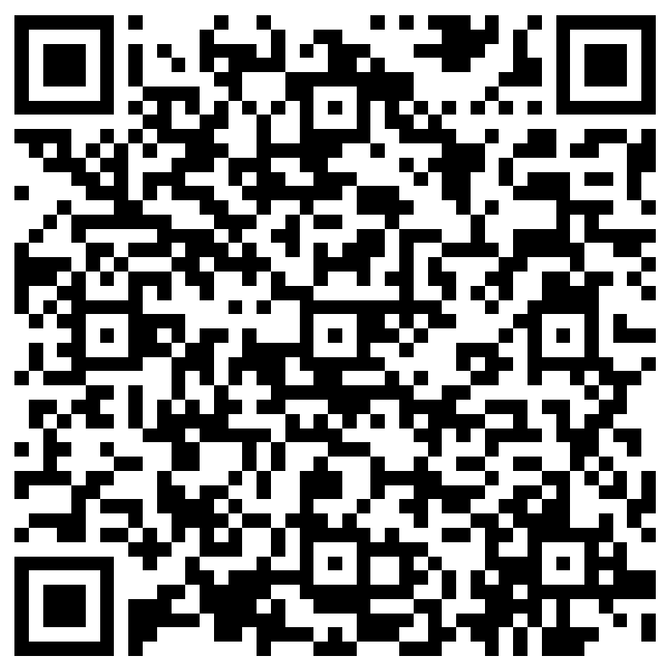
The next Zoom Liaisons Meeting will be held on
Thursday, June 15, 2023 (10:00a-11:00a)
Please let us know if there is a topic that you would like to hear about!
MS Forms: LINK HERE

Slide 25
Human Resource Management Contacts
Chief Human Resources Officer | Jill Fragoso | #3-2634
Employee Relations
Employee Relations Manager | Leila McConnell | #3-4947
Employee Relations Consultant | Carla Popularas | #3-5798
Employee Relations Consultant | Mike Jarvis | #3-1680
Compensation & Benefits
Compensation Manager | Sara Schexnayder | #3-4226
Benefits Manager | Beth Worthen | #3-8742
Benefits Generalist (Leave Administrator) | Mark Gele | #3-7812
Benefits Consultant | Laurie Kirzner | #3-8741
Benefits Consultant | Maddie Hopkins | #3-2455
Benefits Consultant | Terry Varnado | #3-2799
Benefits Coordinator | Krystal Citty | #3-7780
Compensation Analyst | Kel Brownfield | #3-7378
Human Resource Information Systems (HRIS)
Assistant Director, HRIS | Michelle Sharp | #3-2029
HRIS Manager | Jane Behlen | #3-1616
File Room Coordinator | Janet Magee | #3-8158
Administrative Coordinator 3 | Michael Mosley | #3-4834
Human Resources Specialist | Myra Christophe | #3-1781
Talent Management
Talent Acquisition Manager | Shauna Caputo | #3-2047
Human Resources Specialist | Timethia Brown | #3-4835
HR Generalist | Cristina Guillory | #3-2044
HR Generalist | Alicia Rodriguez | #3-8740
HRM Talent Acquisition Coordinator | Tannia Jacob | #3-4832
Talent Development Manager | Denise Robinson | #3-1609
Learning & Development Trainer | Tranell Barton | #3-8640
HRM Talent Development Coordinator | Alexander-Quang Tran | #3-2214

