Slide 1
Welcome Liaisons!
November 2021 Meeting

Slide 2
AGENDA
COVID Vaccination / Testing Program | Michelle Sharp
HRIS Updates Outstanding SF-6 Request Audit Benefit Service Date Audit PER3 Generator ID Badge Replacements & Preferred Name | Michelle Sharp
Compensation Process Updates Proposed Salary Review Plan | Sara Schexnayder
Talent Acquisition New Hire Packet Information Holiday Pay | Shauna Caputo
Talent Development CPTP Compliance Training KDS Compliance Training 2022 Talent Development Support Planning | Matt Copeland
Wrap-up | Juli Sholar

Slide 3


COVID Vaccination / Testing Program
https://lsuh.sc/COVID-19-Vaccination-Documentation-and-Exemption

Slide 4
HRIS
Michelle Sharp, Assistant Director of HRIS

Slide 5
Human Resource Information Systems
HRIS@lsuhsc.edu
Outstanding SF-6 Request Audit
Purpose of the audit is to ensure that:
Pending electronic SF6 requests have been addressed, so that employee’s leave balances accurately reflect taken time
Reminder:
Business Managers have the ability to run the query ZZ_LSUNO_SF6_QUERY_BY_DEPT in the RPT database to review approved and/or submitted requests

Slide 6
Human Resource Information Systems
HRIS@lsuhsc.edu
Benefit Service Date Audit
Purpose of the audit is to ensure that:
Employees have been given credit for all prior state service that has been disclosed and verified, as well as credit for time spent in service-eligible positions at LSUHSC
Employees have not been given credit for service-ineligible positions, or un-verified and ineligible prior state service
Sick and Annual accrual balances reflect an accurate balance based on the Benefit Service Date

Slide 7
Human Resource Information Systems
HRIS@lsuhsc.edu
Per 3 Generator
PS9HRRPT Database
Reporting Tools
Query
Query Manager
ZZ_PER_3_GENERATOR
  Run with the unique EMPLID
  Download to Excel
  Copy/Paste data rows into Original Query tab of the PER 3 Form
  The Original Query tab will prepopulate the employee's header information
*This confirms the employees' information without needing to search for it individually*

Slide 8
Human Resource Information Systems
HRIS@lsuhsc.edu
ID Badge
As a reminder, All persons must present a government issued photo ID, such as a license or passport when receiving their initial or replacement badges. Badges will only be released to the person named on the badge unless otherwise approved.
If your badge is lost, stolen or damaged, you must obtain a replacement through the Office of Human Resource Management.
*Applications for Preferred First Name are available in the Office of Human Resource Management*

Slide 9
Compensation
Sara Schexnayder, Compensation Manager

Slide 10
Compensation
HRM Compensation@lsuhsc.edu
PROCESS CHANGES
Change to PER / Justification Process
No longer need a pre-approval letter/email before submitting a PER
The PER must include a brief rationale for the action
Funding information in PeopleAdmin
The Funding Source Template is the preferred method to include the funding information
A revised form will be added soon
Include a brief (1-2 sentence) rationale/justification for the position in the Notes section

Slide 11
Compensation
HRM Compensation@lsuhsc.edu
Proposed Salary Review Plan
Revise 2017 Unclassified Market ranges
Compare salaries to market and to peers
Focusing on unclassified, faculty, then classified
Plan adjustments to move towards desired levels for July 1, 2022
What we need
Understanding of individuals experience
Help matching positions to survey benchmarks
Your help and patience, more details to follow

Slide 12
Talent Acquisition
Shauna Caputo, Sr. Talent Acquisition Consultant

Slide 13
Talent Acquisition recruittalent@lsuhsc.edu
New Hire Packet
CM-34:
All paid Faculty are required to submit official transcript of terminal degree
All Unclassified/Other Academic appointments require educational verification complete prior to start
Include required licensure/certification credentials as defined by approved PD/posting in hire packet
I-9
Complete I-9 and upload supporting documents in Hire Right for all paid employees
I-9 documents do not need to be included in hire packet for employees whose I-9 is completed and supporting documents are uploaded in Hire Right
Social Security Card
Include a signed social security card for all paid employees for payroll verification purposes

Slide 14
Talent Acquisition recruittalent@lsuhsc.edu
Holiday Pay
In order to receive holiday pay, the employee must be active on both sides of the holiday.
Holidays – Academic, Unclassified, and Classified Employees shall be eligible for compensation on holidays designated in Permanent Memorandum 5 (PM-5) – Holiday Schedule, except:
  When employees are on a restricted or temporary appointment
  When employees are on LWOP immediately preceding and immediately following the holiday period
  When employees are separating from active State service and are not in a paid status before and after the holiday period.

Slide 15
Talent Development
Matt Copeland, Talent Development Manager

Slide 16
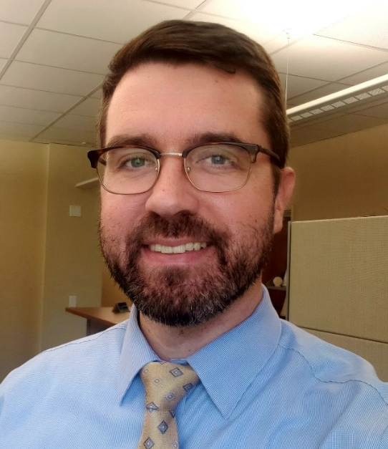
Talent Development talentdevelopment@lsuhsc.edu
Introductions
Matt Copeland, MSHA, MBA
Talent Development Manager
rcopel@lsuhsc.edu

Slide 17
Talent Development talentdevelopment@lsuhsc.edu
CPTP Annual Compliance Training
Compliance Training in KDS
Talent Development Services
  Planning for 2022

Slide 18
We Want To Hear From YOU!
Talent Acquisition is gathering data on hiring successes and challenges.
Please take a few minutes to give us feedback using the Staffing Matrix attached to your email or send me a message directly.
Purpose:
Tracking challenges that you may be having attracting the best talent
Share details of offers that were turned down and why
The more details, the better.
Please contact Juli Sholar with any questions you have.
jshola@lsuhsc.edu or 504-568-2954

Slide 19
The next Zoom Liaisons Meeting will be held on Thursday, December 16, 2021 at 10:00 AM.
Please let us know if there is a topic that you would like to hear about!

Slide 20
HRM Department Contacts
Human Resource Management
Employee Relations
Employee Relations Consultant | Kentrella Crawford | #3-4947
Compensation & Benefits
Compensation Manager | Sara Schexnayder | #3-4226
Benefits & Retirement Manager | Kacy Smith | #3-8740
Benefits Consultant | Laurie Kirzner | #3-8741
Benefits Generalist (Leave Administrator) | Mark Gele | #3-7812
Benefits Specialist | Chakia Hebron | #3-2455
Compensation & Compliance Analyst | Maddie Hopkins | #3-7378
Human Resource Information Systems (HRIS)
Assistant Director, HRIS | Michelle Sharp | #3-2029
HRIS Manager | Jane Behlen | #3-1616
File Room Coordinator | Janet Magee | #3-8158
HRIS Administrative Coordinator | Dee Bonvillian | #3-4834
Talent Management
Assistant Director, Talent Management | Juli Sholar | #3-2954
Sr. Talent Acquisition Consultant | Shauna Caputo | #3-2047
HR Analyst | Timethia Brown | #3-4835
HR Analyst | Briana Williams | #3-4832
Talent Development Manager | Matt Copeland | #3-1609

Slide 21
Questions?

