Slide 1
HRM Liaisons Meeting
November 2022 Meeting

Slide 2
HRM Updates
Denise D. Robinson, Talent Development Manager
Notes:
Kacy is the Benefits Manager but Michelle will be presenting on her behalf.

Slide 3
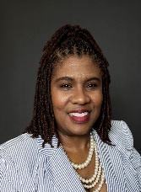
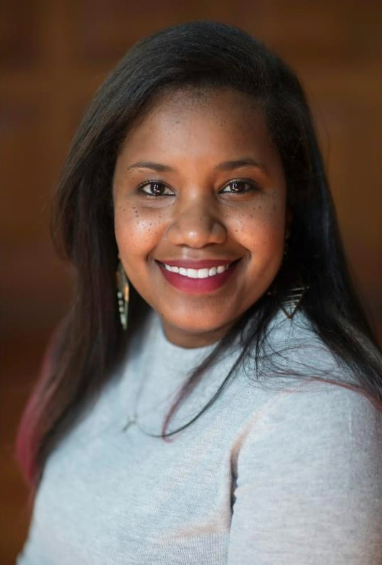

Human Resource Management
nohrm@lsuhsc.edu
HRM Staff Updates
Dr. Tranell E. Barton
Talent Development Trainer
(504) 568-8640
Tannia N. Jacob
HRM Department Coordinator
Talent Acquisition & Ops
(504) 568-4832
Keljuane Brownfield
Compensation Analyst
(504) 568-7378

Slide 4
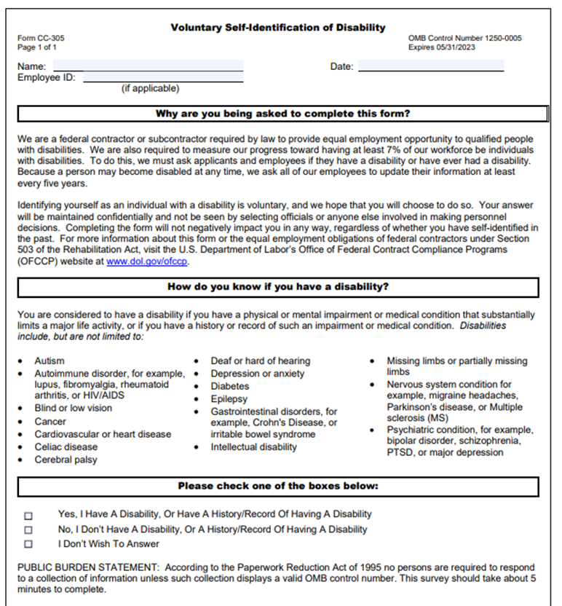
Human Resource Management
nohrm@lsuhsc.edu
Friendly Reminder
    Act 103 of the 2022 Regular Session establishes certain policy, training and reporting requirements for all executive branch state agencies for purposes of compliance with the Americans with Disabilities Act (ADA). It promotes affirmative strategies and goals for employment of individuals with disabilities through development and submission of annual State As a Model Employer (SAME) plan.
    What does this mean for our employees?
    Required Training for all Supervisors and agency ADA coordinators
    Must be complete by November 13, 2022, currently in your KDS portal
      Current response rate is approximately 73%
    New supervisors will be required to complete within 90 days of employment or supervisor position
    Training will be required every 3 years
    Completion of Voluntary Self-Identification of Disability Form for all employees
    Must be complete by September 30, 2022 to ensure compliance with La. R.S. 46:2597(1)
      Current response rate is approximately 35%
    All new employees complete this disclosure as part of their new hire packet
    Required to complete every 5 years
PeopleSoft self-service (Main Menu> Self-Service> Personal Information> Disability
Office of Human Resource Management> Forms> Voluntary Self Identification of Disability

Slide 5
HRM Benefits
Madison Hopkins, Benefits Consultant
Notes:
Kacy is the Benefits Manager but Michelle will be presenting on her behalf.

Slide 6
Benefits & Retirement nohrmbenefits@lsuhsc.edu
Annual Enrollment Update
Annual enrollment ran from October 1st through November 15th
Changes made are effective January 1st
Premium changes will be reflected in the below paychecks:
Monthly Payroll 12/30/2022
Biweekly Payroll 12/02/2022
Residents Payroll 12/15/2022

Slide 7
HRM Talent Acquisition
Shauna Caputo, Talent Acquisition Manager
Notes:
Kacy is the Benefits Manager but Michelle will be presenting on her behalf.

Slide 8
HRM Talent Acquisition
recruittalent@lsuhsc.edu
Forms - Please discard all old versions
People Admin Hiring Proposal Funding Sheet (August 2022)
HR Webpage, HR Resources (PeopleAdmin)
Bottom right corner of People Admin home page
Unclassified & Faculty Employment Packet Checklist (November 2021)
HR Webpage, Forms
Prior State Service Form (May 2022)
HR Webpage, New Employees, Onboarding Forms
Agreement To Submit to Alcohol and/or Drug Test (newly added)
HR Webpage, New Employees, Onboarding Forms

Slide 9
HRM Talent Acquisition
recruittalent@lsuhsc.edu
I-9 Guide
HR Webpage, HR Resources (PeopleAdmin)
  https://www.lsuhsc.edu/administration/hrm/docs/I-9%20and%20E-Verify%20Solutions%20User%20Guide_JAN122018.pdf
Company Code: LHS001
Candidate must complete page 1 by first day of employment
Employer must certify page 2 by third business day after start
Employer must review original I-9 documents
Link to acceptable documents: https://www.uscis.gov/i-9-central/form-i-9-acceptable-documents
When initiating I-9, if you are unsure of start date, leave blank until you certify (to avoid having to correct start date)
Supporting documents must be uploaded in Hire Right (do not include in new hire packet)
If using B & C documents make that selection and upload as one page

Slide 10
HRM Talent Development
Denise D. Robinson, Talent Development Manager

Slide 11
HRM Talent Development talentdevelopment@lsuhsc.edu
Performance Evaluations for Unclassified Staff & Faculty
2023 Timeline
DECEMBER
Communications & Trainings
JANUARY
Employees begin Self-Eval
Communications & Trainings
FEBRUARY
MARCH
APRIL
Mgrs. begin eval
Eval MTG w/ Mgr. & Employee
Eval Submissions Due March 15, ’23
Appeals Due March 31 ‘23
HR Review

Slide 12
HRM Talent Development talentdevelopment@lsuhsc.edu
Performance Evaluations for Unclassified Staff & Faculty
The “Why”
Develop employees into high-performing individuals.
Identify, reward, and retain top talent.
Pinpoint areas of improvement and discuss an actionable plan.
Boost employee morale by eliminating uncertainties and setting clear expectations.
Advances the institution by improving the overall quality of talent.

Slide 13
HRM Talent Development talentdevelopment@lsuhsc.edu
Performance Evaluations for Unclassified Staff & Faculty
Long-Range Goals for Enhancing the Process
Identify an Effective Digital Solution
Incorporate Planning / Goal Setting
Standardize Faculty Process across Schools
Promote Equity & Fairness
Achieve Rater Consistency

Slide 14
Questions?

Slide 15
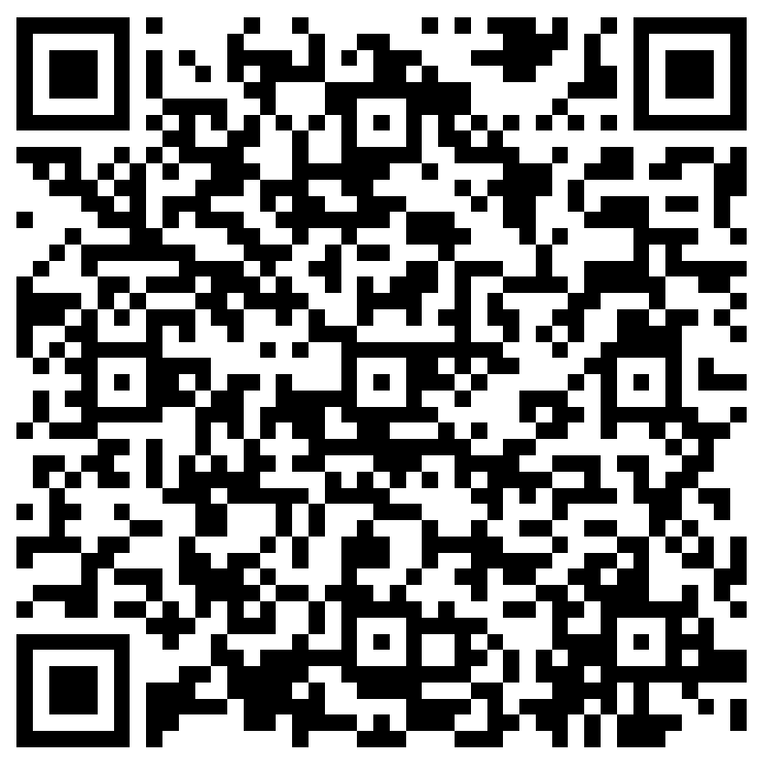
The next Zoom Liaisons Meeting will be held on
Thursday, December 15, 2022 (10:00a-11:00a)
Please let us know if there is a topic that you would like to hear about!
MS Forms: LINK HERE

Slide 16
Human Resource Management Contacts
Employee Relations
Employee Relations Manager | Leila McConnell | #3-4947
Employee Relations Consultant | Carla Popularas | #3-5798
Compensation & Benefits
Compensation Manager | Sara Schexnayder | #3-4226
Benefits Consultant | Laurie Kirzner | #3-8741
Benefits Generalist (Leave Administrator) | Mark Gele | #3-7812
Benefits Specialist | Maddie Hopkins | #3-2455
Compensation & Compliance Analyst | Kel Brownfield | #3-7378
Human Resource Information Systems (HRIS)
Assistant Director, HRIS | Michelle Sharp | #3-2029
HRIS Manager | Jane Behlen | #3-1616
File Room Coordinator | Janet Magee | #3-8158
HRIS Administrative Coordinator | Dee Bonvillian | #3-4834
Talent Management
Talent Acquisition Manager | Shauna Caputo | #3-2047
HR Analyst | Timethia Brown | #3-4835
HR Generalist | Cristina Guillory | #3-2044
HRM Talent Acquisition Coordinator | Tannia Jacob | #3-4832
Talent Development Manager | Denise Robinson | #3-1609
Learning & Development Trainer | Tranell Barton | #3-8640
HRM Talent Development Coordinator | Alexander-Quang Tran | #3-2214

