Slide 1
HRM Liaisons Meeting
September 2022 Meeting

Slide 2
HR Information Systems
Michelle Sharp, HRM Assistant Director of HRIS

Slide 3
Human Resource Information Systems
HRIS@lsuhsc.edu
Record Retention (continued)
    What is not considered a record
    Extra copies maintained for convenience (this includes vital or non-vital documents; copy is the determining factor)
    Departmental personnel files vs. HRM personnel files
    *when in doubt, you can send it to Human Resources for the individual's file*
    Custodian of Record
    I9’s
    Direct Deposit enrollments/changes
    State/Federal tax forms
    Personnel Data Change forms
    Public Service Loan Forgiveness Forms
    PER-2 Original (Dept copy would be a copy and not considered a record)
    PER-3 Original (Dean-Dir would be a copy and not considered a record)
    LSUHSC-NO’s Records Officer, Christie Richardson cric19@lsuhsc.edu

Slide 4
Human Resource Management nohrm@lsuhsc.edu
    Act 103
    Act 103 of the 2022 Regular Session establishes certain policy, training and reporting requirements for all executive branch state agencies for purposes of compliance with the Americans with Disabilities Act (ADA). It promotes affirmative strategies and goals for employment of individuals with disabilities through development and submission of annual State As a Model Employer (SAME) plan.
    What does this mean for our employees?
    Required Training for all Supervisors and agency ADA coordinators
    Must be complete by November 13, 2022, currently in your KDS portal
    New supervisors will be required to complete within 90 days of employment or supervisor position
    Training will be required every 3 years
    Completion of Voluntary Self-Identification of Disability Form for all employees
    Must be complete by September 30, 2022 to ensure compliance with La. R.S. 46:2597(1)
    All new employees complete this disclosure as part of their new hire packet
    Required to complete every 5 years
    The form is available electronically in PS self-service by navigating to:
    Main Menu > Self Service > Personal Information > Disability

Slide 5
HRM Benefits
Kacy Smith, Benefits & Retirement Manager
Notes:
Kacy is the Benefits Manager but Michelle will be presenting on her behalf.

Slide 6
HRM Benefits
nohrmbenefits@lsuhsc.edu
Open Enrollment 2023
October 1, 2022 – November 15, 2022
Changes made will take effect January 1, 2023
If you are not making changes, no action is needed.
EXCEPT: If you are enrolled in an FSA or HSA. You must reenroll in an FSA and reelect HSA contributions in order for those accounts to continue in 2023.
Information will go out to all employees the first week of October
Benefits Fair
Tuesday, October 25, 2022
10:00am – 2:00pm
School of Allied Health, 2nd floor lobby
Meet with benefit vendors

Slide 7
HRM Talent Acquisition
Shauna Caputo, Talent Acquisition Manager

Slide 8
HRM Talent Acquisition recruittalent@lsuhsc.edu
People Admin Hiring Proposal Funding Sheet
Please discard old versions!
Newly added:
Regular or POA (POA end date)
For Faculty appointments:
  Non-Tenure or Tenure-Track (1,2,3,4 year)
  Joint appointment - department number & effective date
Note:
Candidate’s personal email address is for NEO invitation
Use Hiring Proposal Funding Sheet for position approvals/recruitments completed in People Admin
  (NOT completed in People Admin - House Officer, Fellow/Intern, Gratis, Grad Asst., Student Worker)

Slide 9
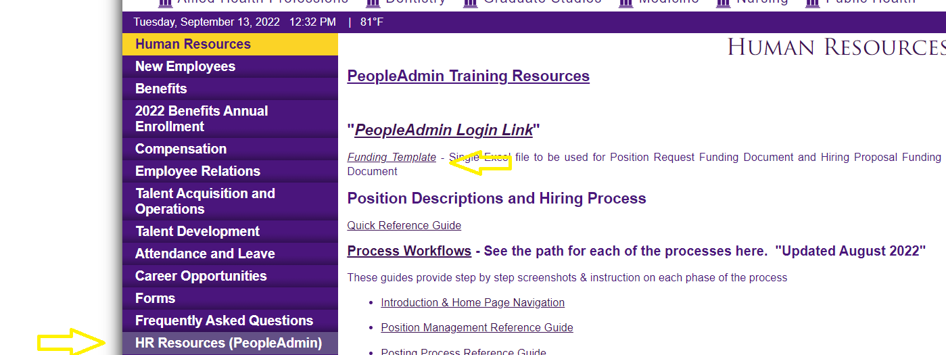
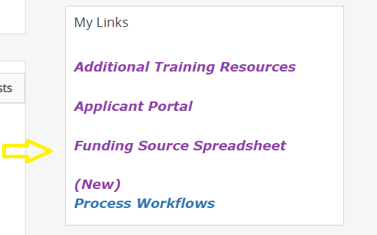
HRM Talent Acquisition recruittalent@lsuhsc.edu
Where to Locate Hiring Proposal Funding Sheet
HR Webpage, HR Resources (PeopleAdmin)
Bottom right corner of People Admin home page

Slide 10
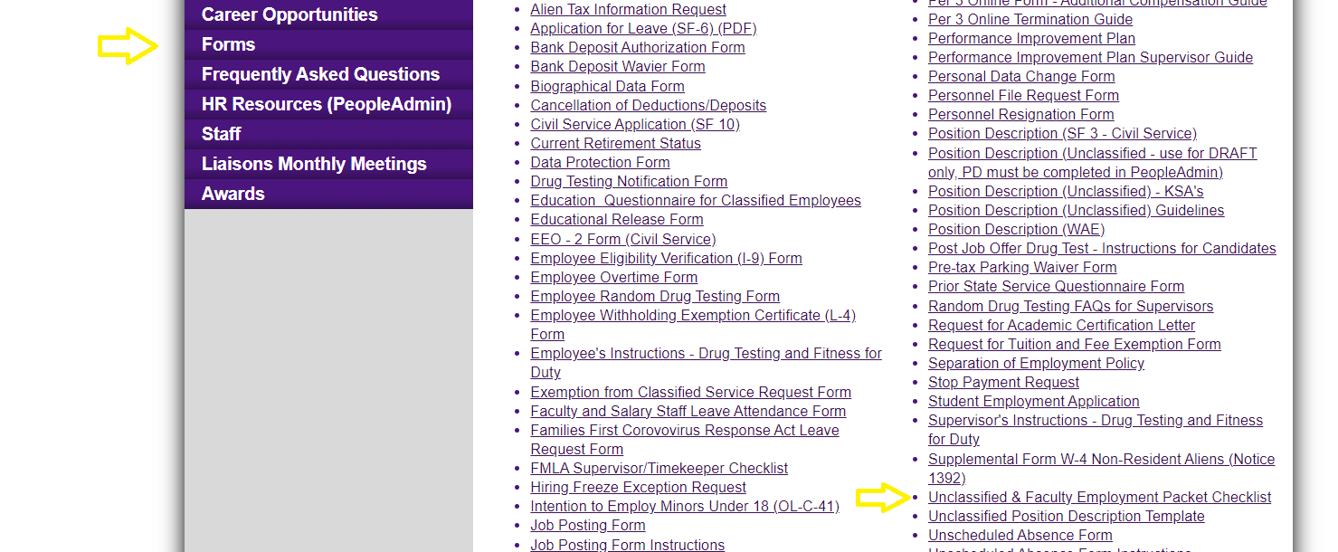
HRM Talent Acquisition recruittalent@lsuhsc.edu
Where to locate Unclassified & Faculty New Hire Employment Packet Checklist
Please discard old versions!
Note:
Per CM-34
  HR can’t use authorization for educational release form for faculty or foreign credentials
  An official transcript of terminal degree is required for all paid faculty
  Credentials and licensure are required for all faculty appointments (please include in new hire packet when ever possible)
  Education credentials are required to be approved by HR prior to start date for unclassified employees (including internal employees.) Send authorization for educational release form to recruittalent@lsuhsc.edu

Slide 11
HRM Compensation
Sara Schexnayder, HRM Compensation Manager

Slide 12
HRM Compensation nohrmcompensation@lsuhsc.edu
Position Request
Initiator - Modifies an existing PD or creates a new one (optional)
Posting
Initiator - Creates posting (optional)
HR Operations - Check approval of PD
Hiring Proposal
Initiator - Starts hiring proposal (optional)
Department Approver - Starts or reviews request
Department Head (optional)
Budget Approver - Review and approve
Dean or Vice Chancellor (School/Division Approver) - Review and approve
Compensation - Reviews grade, salary range and position specifications (for PD updates not requiring grade change or hiring/filling open position - move to approved)
Chancellor - Review and approve
Compensation - Updates position data in PeopleSoft
Initiator and Department Approver - Notified of approval, starts posting
Department Approver - Creates or Approves posting
Department Head - Reviews (optional)
Talent Aquisition - Final Review of Advertisement and position details
Position Posted - Initiator and Department Approver notified of status
Applicant Reviewer - Reviews applications and moves in workflow through Recommend for Hire (must move to campus interview before Recommend for Hire)
Initiator and Department Approver notified of Recommend for Hire, start hiring proposal
Department Approver - Creates or Approves hiring proposal
Department Head - Reviews (optional)
Talent Aquisition - Reviews candidate qualifications
Compensation - Provides HR Recommended salary range
Budget Approver - Adds approved starting salary
Dean or Vice Chancellor (School/Division Approver) - Approves or changes/enters approved starting salary
Initiator or Department Approver - recieves notice to extend offer and moves to "Offer Accepted." If rejected, sends back through with revised offer to school/division approver or moves to next candidate
HR - Compensation, Talent Aquisition (Review) & HR Director process candidate
Chancellor - Reviews and Approves
HR Operations - Enters new hire into PeopleSoft
Talent Aquisition (HR Final)
Unclassified and Administrative Faculty PeopleAdmin Process Steps

Slide 13
HRM Talent Development
Denise Robinson, Talent Development Manager
Notes:
PM-20 and Staffing Updates. Welcome, Denise!!

Slide 14
Performance Evaluation System
The yearly performance cycle from planning to evaluation for Classified Employees
HR PES Final Review
2
10
3
4
5
6
7
8
9
1
PES Plan Review
The Human Resources representative reviews the evaluation for accuracy.
Supervisor enters the employee’s work and behavior expectations in accordance with the guidelines of Louisiana State Civil Service.
Employee Acknowledges Evaluation Meeting
Second Level Approval of PES Plan
After the PES evaluation meeting has taken place, the Employee acknowledges.
The second level Supervisor reviews the plan for accuracy.
Supervisor Acknowledges Evaluation Review Meeting
PES
Supervisor Acknowledges Plan Review Meeting
After the PES evaluation meeting has taken place, the Supervisor acknowledges.
After the PES plan meeting has taken place, the Supervisor acknowledges.
Second Level Supervisor Approval
Employee Acknowledges PES Plan
After reviewing the Supervisor’s evaluation, the second level Supervisor approves.
After the planning meeting has taken place, the Employee acknowledges.
Supervisor Evaluation
HR Reviews PES Plan
At the end of the performance cycle, the Supervisor appraises the Employee.
The Human Resources representative reviews the plan for accuracy.
Notes:
Steps 1 - 5 are colored in blue. These are the steps that will be completed in the planning period.
Steps 6 - 10 are colored in red. These are the steps that will be completed in the performance evaluation period.

Slide 15
Performance Evaluation System
HRM Talent Development
TalentDevelopment@lsuhsc.edu
Planning | Review Phase
Talent Development is currently reviewing the Plans submitted to confirm each submission is compliant with standards set by the State Civil Service and best practices.
HRM will complete its review by 9/30/2022.
In the process, supervisors may have their submissions returned to them if they do not meet the SCS standards. Talent Development will provide assistance in properly completing the Plan.

Slide 16
HRM Talent Development
TalentDevelopment@lsuhsc.edu
PES Planning
Planning window has ended. Employee Plans were due on September 9, 2022.
Overdue Plans must be submitted ASAP or risk flagging in the upcoming SCS audit.
To formulate an equitable plan, Talent Development suggests remembering some key best practices in mind!
  Do not include any medical information in a planning.
  When formulating these expectations, follow the SMART model. Be Specific, and make goals Measurable, Attainable, Realistic, and Time-Based.
  Be detailed in describing tasks or behavior expectations!
Provided below are Suggested Milestones to follow to remain on track for completion prior to the deadline!
Step |  | Suggested Dates
1 | Supervisor PES Plan Review | August 1 – August 8, 2022
2 | Second Level Supervisor Approval | August 9 – August 16, 2022
3 | Supervisor Acknowledges Planning Meeting Occurred | August 17 – August 31, 2022
4 | Employee Acknowledges PES Plan | September 1 – September 9, 2022
5 | HRM Reviews and Approves
2022-2023 PES
Notes:
HRM suggests following these milestones to complete the various steps of the PES process in a timely manner, ensuring everyone has ample time to complete their PES steps and staying

Slide 17
HRM Talent Development
TalentDevelopment@lsuhsc.edu
Supervisor Training Series
Talent Development is currently developing a comprehensive Supervisor Training Series to assist our supervisors in understanding and properly executing various processes they will need to conduct in their supervisory role that may require training/guidance.
Some examples include:
Posting a new position on PeopleAdmin
How to properly complete a new hire packet
Information about FMLA, ADA, etc.
Best Practices for conducting performance evaluations.

Slide 18
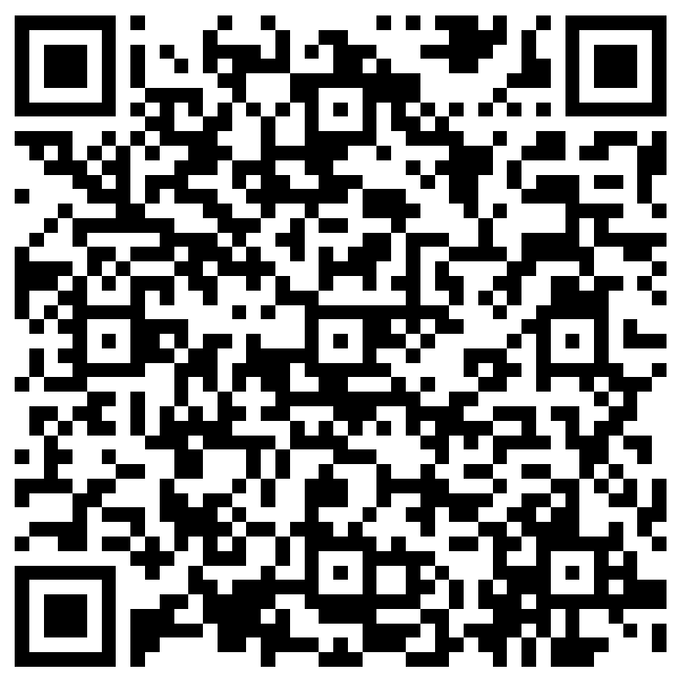
The next Zoom Liaisons Meeting will be held on
Thursday, October 20, 2022 (10:00a-11:00a)
Please let us know if there is a topic that you would like to hear about!
MS Forms: LINK HERE

Slide 19
Human Resource Management Contacts
Employee Relations
Employee Relations Manager | Leila McConnell | #3-4947
Employee Relations Consultant | Carla Popularas | #3-5798
Compensation & Benefits
Compensation Manager | Sara Schexnayder | #3-4226
Benefits & Retirement Manager | Kacy Smith | #3-8740
Benefits Consultant | Laurie Kirzner | #3-8741
Benefits Generalist (Leave Administrator) | Mark Gele | #3-7812
Benefits Specialist | Maddie Hopkins | #3-2455
Compensation & Compliance Analyst |  | #3-7378
Benefits Analyst | Kel Brownfield | #3-7780
Human Resource Information Systems (HRIS)
Assistant Director, HRIS | Michelle Sharp | #3-2029
HRIS Manager | Jane Behlen | #3-1616
File Room Coordinator | Janet Magee | #3-8158
HRIS Administrative Coordinator | Dee Bonvillian | #3-4834
Talent Management
Assistant Director, Talent Management | Juli Sholar | #3-2954
Talent Acquisition Manager | Shauna Caputo | #3-2047
HR Analyst | Timethia Brown | #3-4835
HR Generalist | Aminah Moody | #3-4832
HR Generalist | Cristina Guillory | #3-2044
Talent Development Manager | Denise Robinson | #3-1609
HRM/Talent Development Coordinator | Alexander-Quang Tran | #3-2214

Slide 20
Questions?

